Slide 1
Module 1
Introduction to Migrant Community Mediation
This project has been funded with support from the European Commission. This publication [communication] reflects the views only of the author, and the Commission cannot be held responsible for any use which may be made of the information contained therein 2019-1-SE01-KA204-060535

Slide 2
Welcome to the
Module 1 of the Migrant Community Mediation Course
In this Module we will learn:
What is a Migrant Community Mediator? The power of peer support
Meet some Migrant Community Mediators/Success Stories
Barriers and Challenges that Refugees and Migrants face (language, family, community, settlement)
Challenges that a Migrant Community Mediator can face
Understanding diversity, equality and inclusion

Slide 3
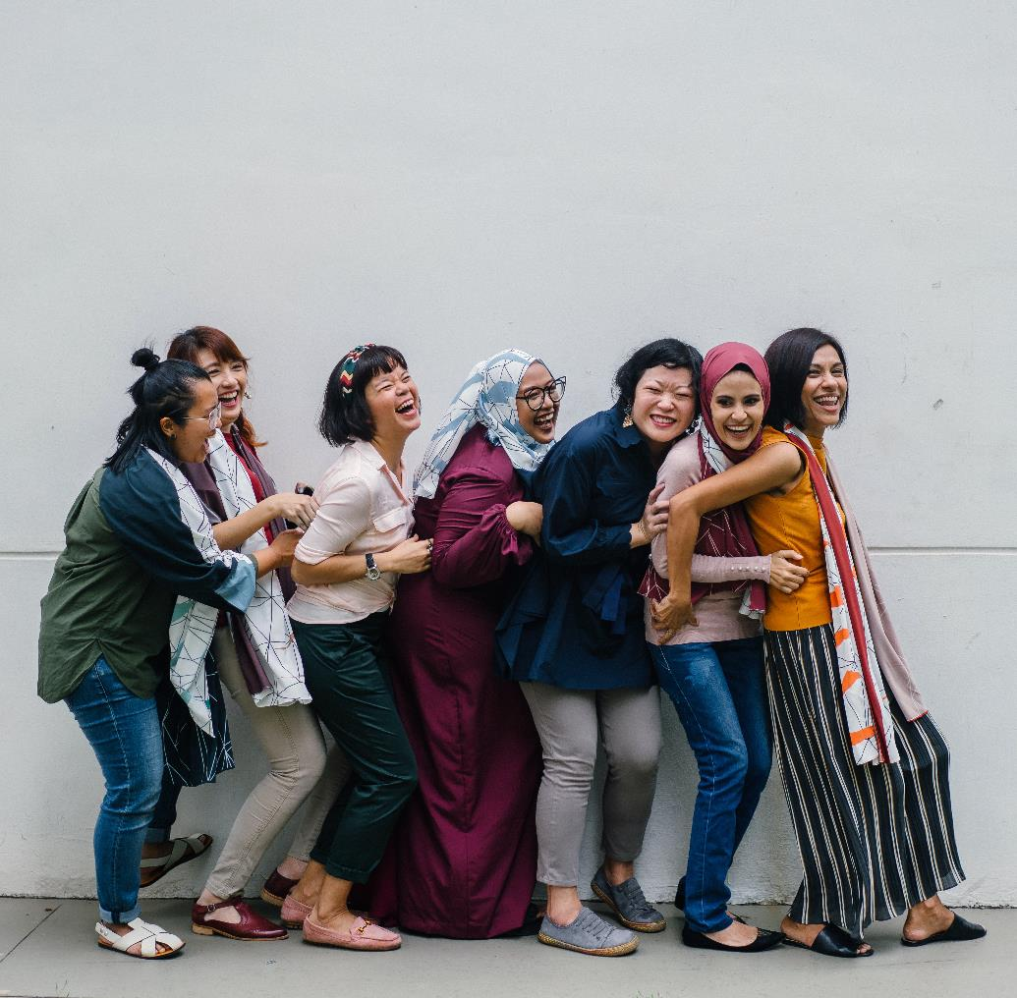
“The mediator between head and hands must be the heart!”
― Thea von Harbou, Metropolis

Slide 4
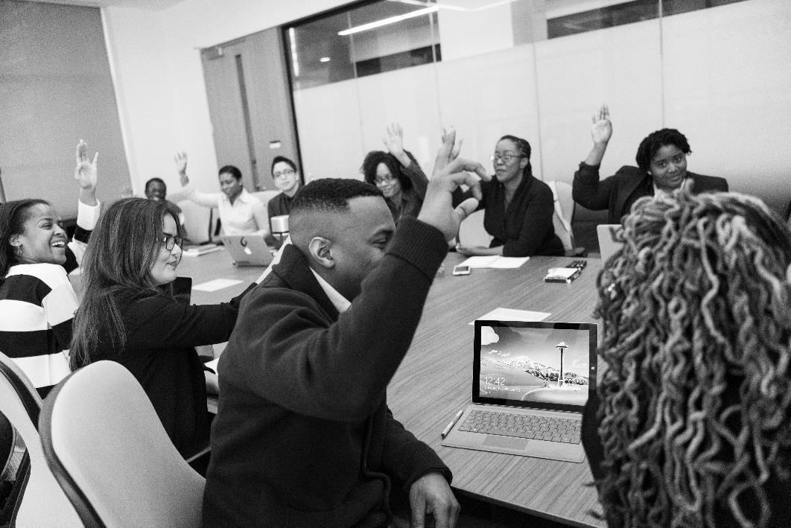
Who will benefit from this module?
Teachers and community educators will be empowered to integrate migrant community mediation education into their organization’s activities and the training currently offered to migrant groups
Migrants, refugees, members of new communities

Slide 5
Why Study this Module?
INTRO TO MEDIATION
Get to know the power and potential of Migrant Community Mediation
KNOWLEDGE
Leadership and Advocacy skills in developing strong, positive and equitable communities
STRATEGY
Effecting change - strategies and new approaches to community mediation and active inclusion (HOW)
COMMUNICATION AND MEDIA PRACTICES
Tools and skills to become an informed voice in media debates and in policy development and resources planning
RESOURCE MODELS
Levering public and community investments, attracting resources

Slide 6
Our context.. Migration in the EU
The EU is and will continue to be a region of immigration. European communities are composed of different ethnic, cultural and religious groups. The rights of minorities are protected by the Charter of Fundamental Rights and diversity is celebrated as an added value for open and democratic societies.
THE RIGHTS OF REFUGEES AND MIGRANTS
Refugees and Migrants are entitled by international law and human rights principles to receive protection. Self-reliance and integration are key in offering them protection and in being accepted by and contributing to the host societies.

Slide 7
The Migrant Community Mediator

Slide 8
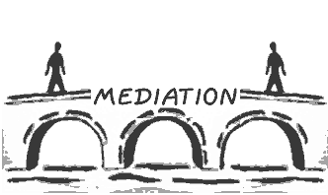
Understanding Mediation
By definition, the mediator is "in the middle", a bridge between the parties, either face-to-face (a mediation meeting) or remotely (shuttle mediation between one party and the other).
A formal definition – mediation is a negotiation facilitated by a third party.

Slide 9
Understanding others: Empathy
Empathy is the ability to understand and share another person’s feelings and emotions. It is essential to building good relationships.
The research shows that empathy is partly innate and partly learned. Everyone can improve, however. Here are eight ways to strengthen your own empathy, which will become useful in your non-formal mediation path:
1. Challenge yourself. Undertake challenging experiences which push you outside your comfort zone. Learn a new skill, for example, such as a musical instrument, hobby, or foreign language. Develop a new professional competency. Doing things like this will humble you, and humility is a key enabler of empathy.
2. Get out of your usual environment. Travel, especially to new places and cultures. It gives you a better appreciation for others.
3. Get feedback. Ask for feedback about your relationship skills (e.g., listening) from family, friends, and colleagues—and then check in with them periodically to see how you’re doing.

Slide 10
Understanding others: Empathy
4. Explore the heart not just the head. Read literature that explores personal relationships and emotions. This has been shown to improve the empathy of young doctors.
5. Walk in others’ shoes. Talk to others about what it is like to walk in their shoes—about their issues and concerns and how they perceived experiences you both shared.
6. Examine your biases. We all have hidden (and sometimes not-so-hidden) biases that interfere with our ability to listen and empathize. These are often centered around visible factors such as age, race, and gender. Don’t think you have any biases? Think again—we all do.
7. Cultivate your sense of curiosity. What can you learn from a very young colleague who is “inexperienced?” What can you learn from a client you view as “narrow”? Curious people ask lots of questions (point 8), leading them to develop a stronger understanding of the people around them.
8. Ask better questions. Bring three or four thoughtful, even provocative questions to every conversation you have with clients or colleagues.

Slide 11
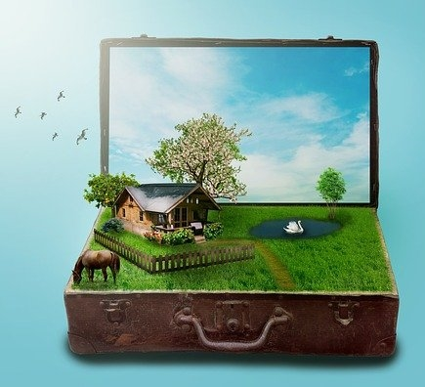
Understanding Migration
Migration is the movement of people from one place to another and can be either temporary or permanent. Triggers may be personal and/or professional factors including:
a desire to work or study in a different country
a need to move away from dangerous or challenging environments
an economic necessity to find employment

Slide 12
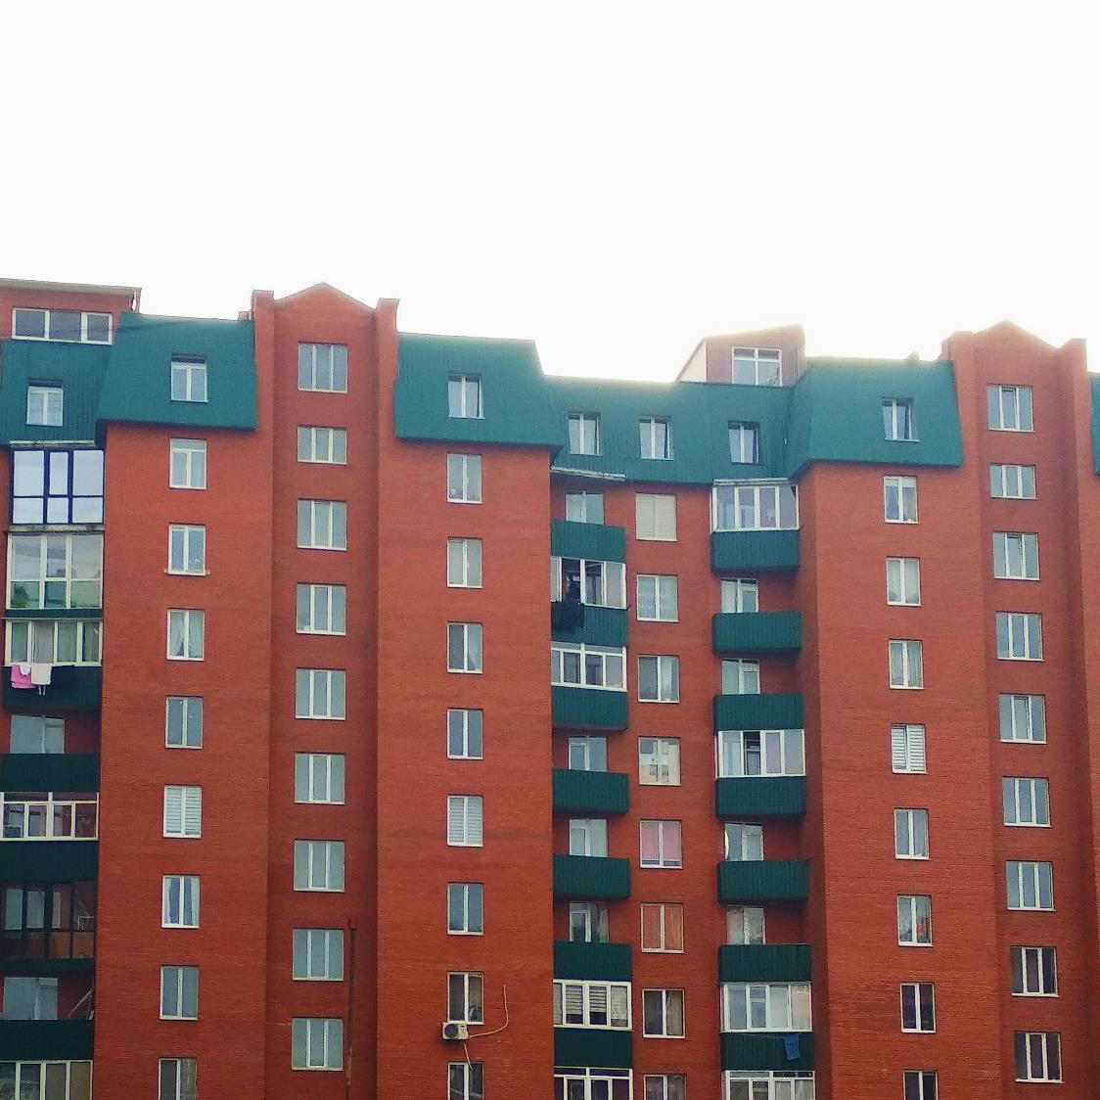
Understanding Community
Community is a unified body of individuals: such as
- the people with common interests living in a particular area broadly
- a group of people with a common characteristic or interest living together within a larger society

Slide 13
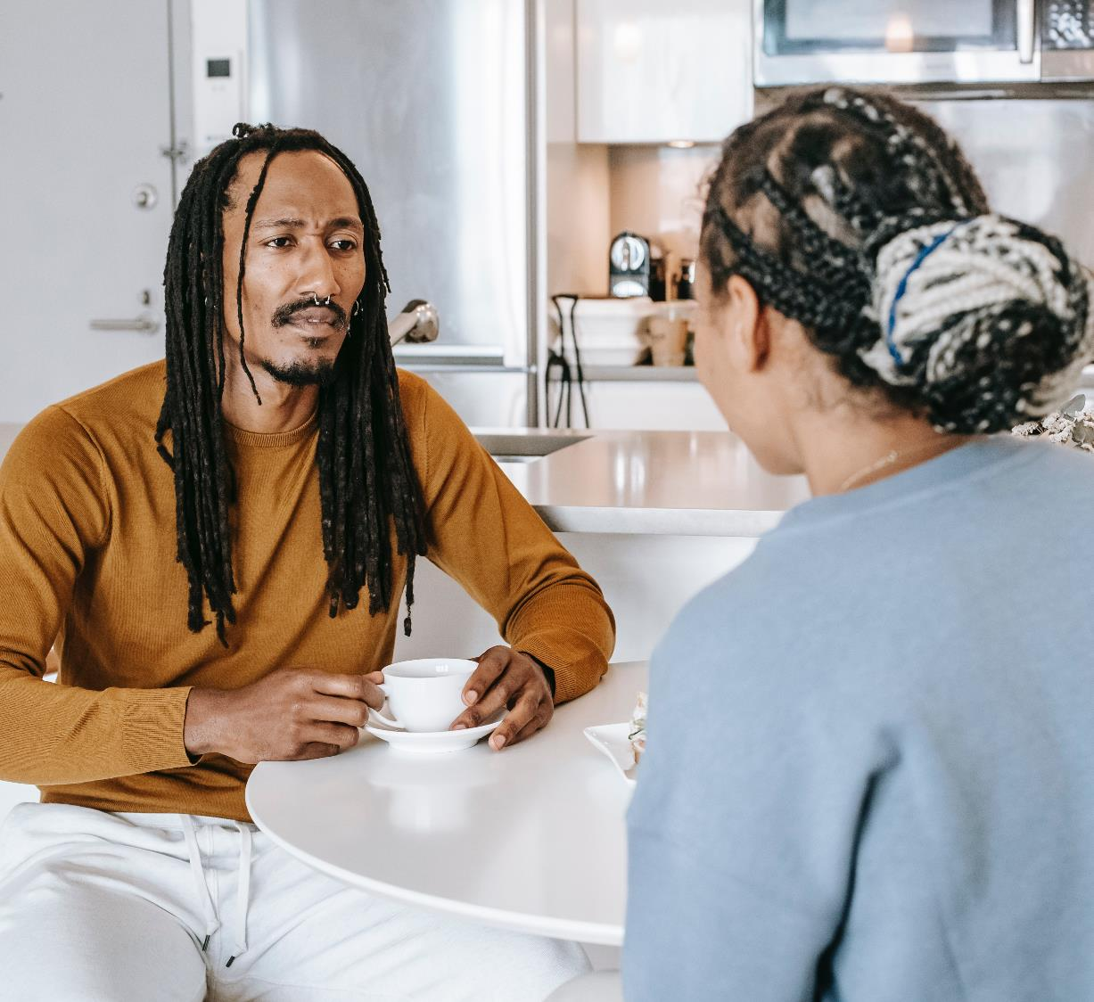
Mediator
In the context of this project, Migrant Community Mediator is not someone who is necessarily providing legal mediation, but rather a non-formal process of negotiation, support, consultation of the involved parties, and overall the COMMUNICATION.

Slide 14
A Migrant Community Mediator
- Is a person who identifies as a migrant and mediates a situation, relationship or communication between other persons who identify as migrants, or between migrant and non-migrant persons, with the aim of reaching the best possible solution for parties involved.
The Migrant Community Mediator can be:
Coming from the group(s) that is (are) in need of mediation (internal mediator)
External to the group(s) in need of mediation(external mediator)
A Migrant Community Mediator is someone the community trusts

Slide 15
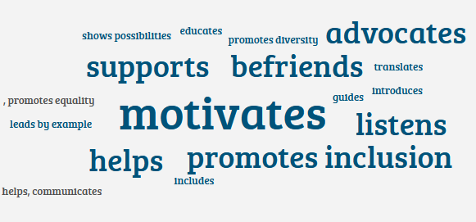
The true scope of a migrant community mediator
A Migrant Community Mediator is someone who does some or all of these things for the migrants, refugees, and new communities:
helps, communicates, listens, advocates on different levels in the community/society, promotes equality, diversity and inclusion, guides, leads by example, motivates,
shows that it’s possible to succeed in the new place of life, educates, supports, befriends.

Slide 16
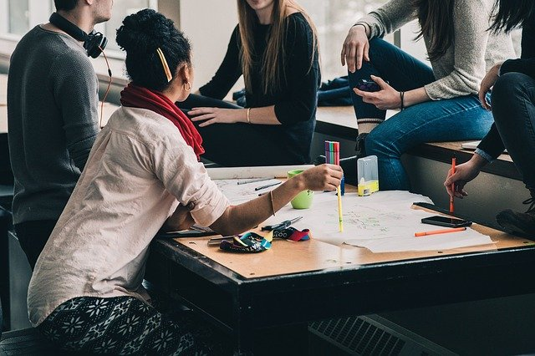
The use of migrant community mediation
Migrant Community Mediation allows migrants to provide support to their peer migrants and their community, by negotiating, impartially, the communication about a certain issue, or an aim.
By using this method, it is easier for all involved to determine the problem, work out the options, and come to the solution.

Slide 17
IMAGINE
A family of migrants comes to a new community
There is a Migrant Community Mediator to welcome them
He/she works closely with the local community centre to organise their orientation day
The Mediator organises the orientation, allowing the family to meet representatives of their neighbourhood, school, community centre
The family experiences no resistence from the host community
The community seems to lack the negative perception regarding migrants
Everyone celebrates singing: „Imagine all the people Livin' life in peace” by John Lennon ☺
This must be due to the Mediator’s work in FIGHTING THE NEGATIVE NARRATIVE AGAINST MIGRANTS

Slide 18

CASE STUDY - FIGHTING THE NEGATIVE NARRATIVE AGAINST MIGRANTS
Outside Multicultural Magazine (https://outsidemagazine.ie) is an online magazine with a goal to provide an online space, where integration, multiculturalism and diversity are supported. It features videos and content by authors with different ethnical backgrounds. They covering all aspects of inclusion and a range of topics from everyday life. It was started by two individuals, expats, who moved to Ireland from Bosnia and Herzegovina.
Outside is showing what it is like for the misplaced, for those who became out of place. They show what is means to accept this identity and love it, to despise it, to come from the outside. They find out what the ‘outsiders’ have to say about life, no matter what they define as their home and what their geographical location is at the moment.

Slide 19


READ:
How Outside Multicultural Magazine commuicates ‘ softly’.
Click here
„We all should know that we live on the planet Earth, “Together”, all the time and our different cultures, look, skin, clothes, religion is our treasure. If you talk to someone from another continent you will recognise the same problems, same needs, same wishes as you have. If we meet a migrant or someone different in our city, let’s think what reason they had to come miles and miles to another country.
We should be aware that negative narrative, ignoring new cultures or religions, not giving a chance for inclusion can in the end lead to violence. We should know who we are, hold on to that and respect that, then start learning about new religions, cultures in our communities. Also, give a chance to others to show their story and give a chance to show that they are friendly and as good as we are all. Most importantly, do not generalise, there is a bit of good and bad in all of us.”
Vedran Ivandic, Co-Founder, Outside Multicultural Magazine

Slide 20
Why become a Migrant Community Mediator?

Slide 21

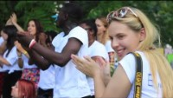
Watch and learn
Click to view
I, as a migrant, wanted to give it back to Ireland and my community. In order to do that, we decided to create an international project about integration and bringing the communities together. The main aim of this international youth exchange was to clarify the fact that migrants should not be abused, but understood and supported instead.”
Kelvin Akpaloo, Irish Youth Leader and one of the authors of this project

Slide 22
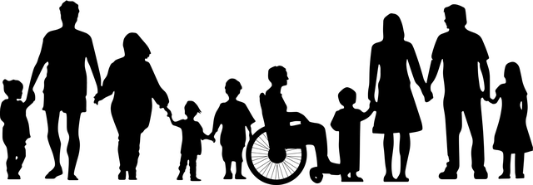
Being a Migrant Community Mediator means you are an Active Citizen
Active Citizenship is a term used to describe the involvement of individuals in public life and affairs
Active citizens are people who effect change and become actively involved in the life of their communities; tackling problems and bringing about change

Slide 23
Active Citizenship – Benefits for Refugees and Migrants
Refugees and migrants can benefit greatly from becoming active citizens in their communities.
They can lay the foundations for friendships with natives of the community and empower themselves to be changemakers effecting positive actions in their newfound homes.
By engaging in community groups, refugees and migrants learn more about their host countries, local people and customs.

Slide 24
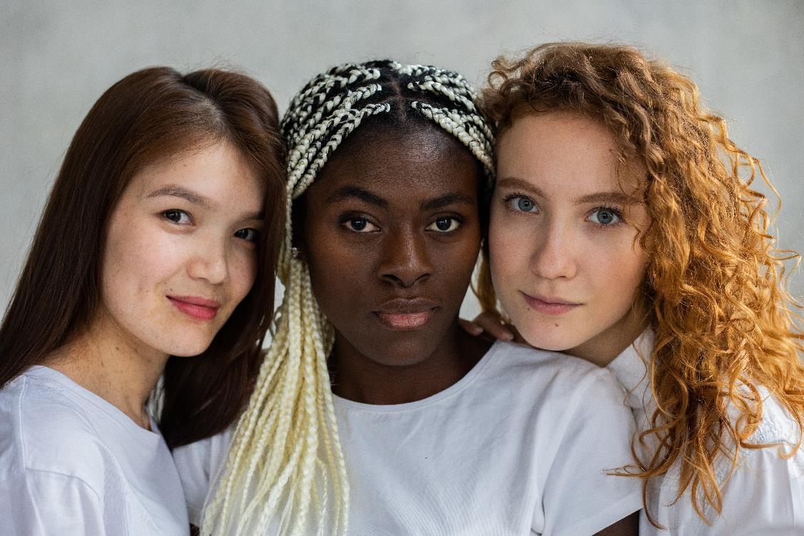
Active Citizenship can help negate “othering”
“Othering” can stem from:
ethnic/racial differences between refugees/migrants and their host communities
the Refugee/migrant label or status can be negatively experienced
treatment by society/host community
“Regardless of our differences, we are all the same.”
- Marshal B Rosenberg, American Psychologist

Slide 25
Refugee/Migrant Active Citizenship
Benefits for Communities
Not only will they get to know and understand the newly arrived group, they will also benefit from the new skills, knowledge and resources that the refugees and migrants bring from their own countries.
The host communities can benefit greatly from the refugees and migrants becoming involved as active citizens.

Slide 26
The Power of Peer Support
What is it like to be a new comer, a migrant, a refugee? Who knows best then the people who have experienced it. That’s where the strongest empathy comes from and it gives a special effectiveness to peer mediation.
Being in the same or similar situation before, gives Migrant Community Mediators precious knowledge and experience that makes their support valuable and relevant to their peers.
Witnessing other migrants who are active in the society empowers and evokes instruments to live active lives in the new communities.
Inclusion does not have to be a slow process. By reaching to peer support, migrants can fast forward some traditionally slow steps to start enjoying inclusion and feeling included rather sooner, than later.
EMPATHY
KNOW-HOW
EMPOWERMENT
INCLUSION

Slide 27
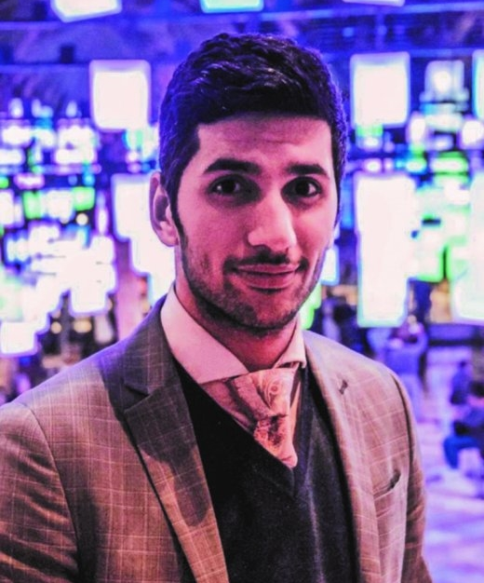
Meet some Migrant Community Mediators/Success Stories
Hooman was born in Iran, raised in Germany and is living and working in the Netherlands. He commits to creating an inclusive society through & with newcomers, both locally and globally. For this purpose, he started the social enterprise Society in Motion in 2017. Here, a multidisciplinary team is working towards this vision to empower newcomers through events and festivals, promote social cohesion and consult on policy for municipalities.

Slide 28
At Society in Motion, a multidisciplinary team is working towards the vision of an inclusive society in order to empower newcomers through events and festivals, promote social cohesion and consult on policy and carry out government contracts.
Friesland remains my home base. For a long time, I felt like a bit of a second-class citizen; always that idea that I had to prove myself over and over again. It was only in Friesland that I was able to get rid of that feeling for the first time. In Sneek, for example, still inexperienced, I got my first Mienskips project: Sneek Connect. But twenty years after I myself struggled with my new existence, I still come across people with the same problems in asylum seekers' centres. That's what drives me.

Slide 29
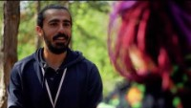
The Video:
Example of Peer to Peer Mediation Result
Hooman’s initiative ‘New Faces’ involves newcomers with a refugee background as volunteers at Dutch festivals.
Last year New Faces launched a toolkit with tools and tips for festivals that want to involve refugees.

Slide 30
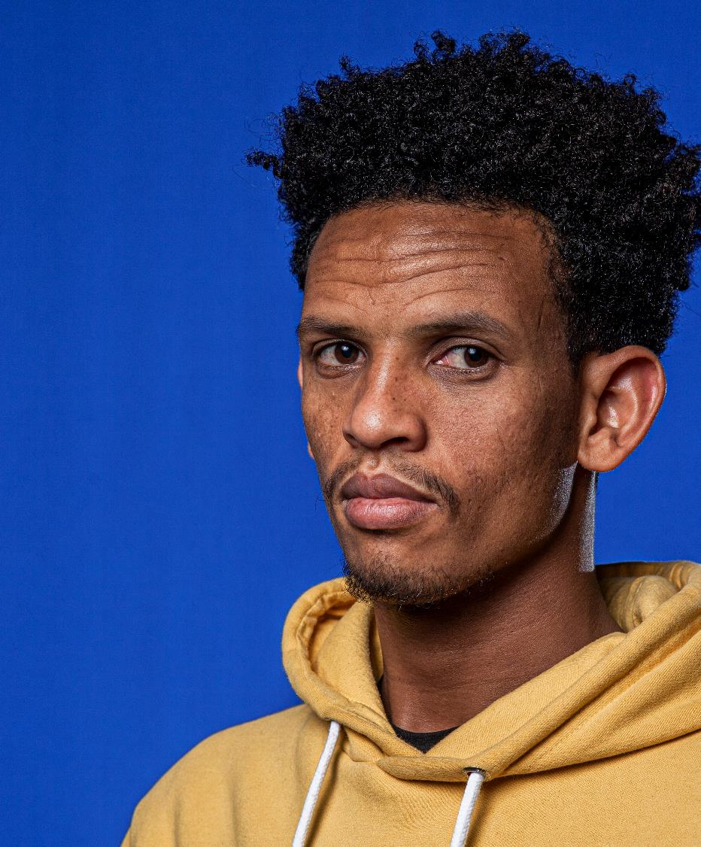
I have been in the Netherlands for about 6 years now. I come from Eritrea and came here alone. Since I have been in the Netherlands, I have had many challenges. Finding friends, work and education. Thanks to a few passionate people in Leeuwarden, I have been able to take steps. In October 2017 I met Kevin and we are friends. He is different from other buddies. He doesn't only support me with language. We do a lot more together. I'm going to visit his parents, have dinner with his grandparents and talk to his friends. This is important, that people who want to do something for newcomers do more than what their job describes.
- Daniel

Slide 31
Activity
Use the Diversity Wheel from Johns Hopkins University. to profile diverse groups in your community
The Diversity Wheel is a useful tool to use to overcome the us vs them mentality. Use it to help find a common ground among diverse groups.

Slide 32
The centre of the wheel represents internal dimensions that are usually most permanent or visible.
The outside of the wheel represents dimensions that are acquired and change over the course of a lifetime.
The combinations of all of these dimensions influence our values, beliefs, behaviours, experiences and expectations and make us all unique as individuals.

Slide 33
Please study the wheel!
Think: how flexible do you think the traits from the outside of the wheel are? Can people influence these and change them easily? Should they?
What about the traits inside of the wheel?
How diverse is you community when you look at them from the perspective of this wheel?
How acceoting are you about all the differences and different combinations that come out of this wheel’s perspective?
Is your community flexible and accepting about the same?
Diversity Wheel
How to use it?

Slide 34
Barriers and Challenges that Refugees and Migrants Face

Slide 35
Most Common Barriers and Challenges that Refugees and Migrants Face
If the native language of the migrant is different from the language of the host country, the communication, both oral and written are difficult.
Sometimes even with the same language there are differences and difficulties.
This influences every aspect of life.
For some keeping the family together is a challenge, for some raising children in a new, unfamiliar culture poses an obstacle, for some, starting a new family is the next natural step that could be delayed by their new situation.
Getting the sense of belonging is very important for normal social life and happiness. Being accepted into community, acquiring friends, becoming an equal member of the society is not easy, especially if there is a combination of other barriers.
Housing, employment and settlement are all more difficult tasks for refugees and migrants. Can be influenced further by a mix of circumstances, for example:
Legal obstacles to work and to housing
Differences in qualification
Lack of connections and networking
Language
Family
Community
Settlement

Slide 36
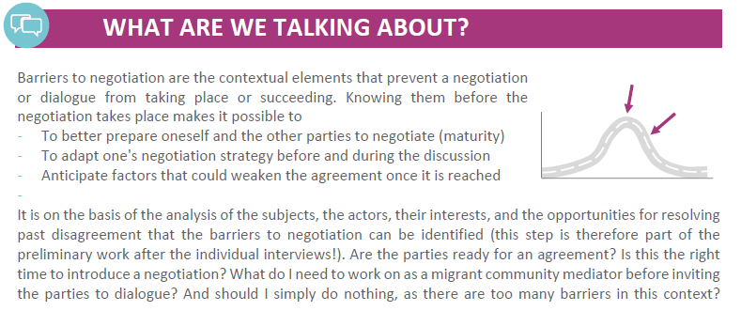

Slide 37
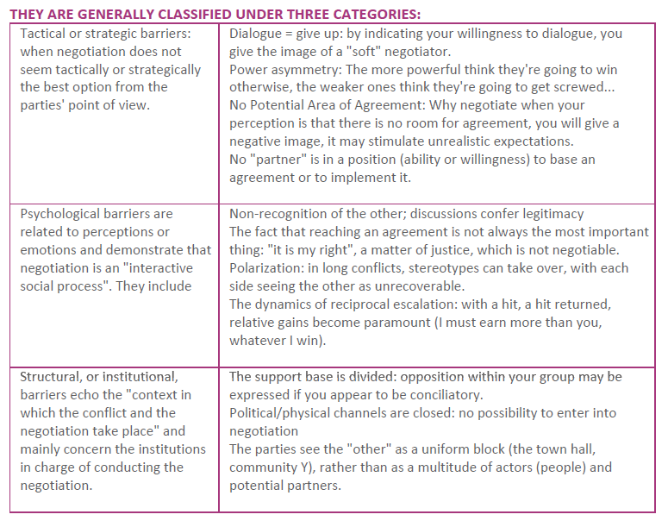
The barriers to
negotiation

Slide 38
You can help by:
As a Migrant community Mediator, the previously mentioned barriers are the fields in which your help would be very often needed.
To help you can provode translation and accompany your peer migrants at the meetings, support them with phone calls, teach them the language
Find out about reliable childcare services, family supports
Help them make friends, introduce them to the members of your community
Point them towards up-to-date information and institutions about housing, jobsearch and other areas they might need

Slide 39
Let’s dig deeper into some of the most influential barriers

Slide 40
Psychological barriers linked to perceptions or emotions
Psychological barriers are beliefs that a person has about himself/herself regarding his ability, potential, self-worth.. they can be called unhealthy or maybe incorrect thought patterns.
Social barriers are barriers to entry which are created by the culture of the community, i.e. people's behaviour towards newcomers or others in general.

Slide 41
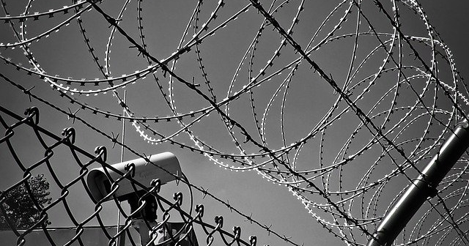
Development of
Socio -psychological Barriers
“The past is never where you think you left it.”
― Katherine Anne Porter

Slide 42
The Reasons Behind the Socio-psychological Barriers
Intractable conflicts have an imprinting effect on individual and collective life in affected societies
Society members living under harsh conditions of inter-societal conflict experience severe ongoing negative psychological effects
In addition, these narratives rest on a foundation of shared emotions that adds still another powerful vector to the functioning of the barriers¹
¹The nature of socio-psychological barriers to peaceful conflict resolution and ways to overcome them, Daniel Bar-Tal & Eran Halperin, conflict & communication online, Vol. 12, No. 2, 2013

Slide 43
Freezing: Manifestation of the Psychological Barrier
The state of FREEZING is reflected in continuing reliance on widely held societal beliefs that support the conflict, reluctance to search for alternative information and resistance to well-founded arguments that challenge these positions (Kruglanski, 2004;Kruglanski & Webster, 1996; Kunda, 1990).
Freezing contributes to barriers and is a form of barrier, experienced by the person with life experiences full of conflicts, such as war.

Slide 44
Unfreezing: Creating the Motivation
Overcoming the psychological barriers that prevent a change
Re-evaluating the held beliefs and attitudes
Searching for new information and ideas
Accept the new alternatives
1
2
3

Slide 45
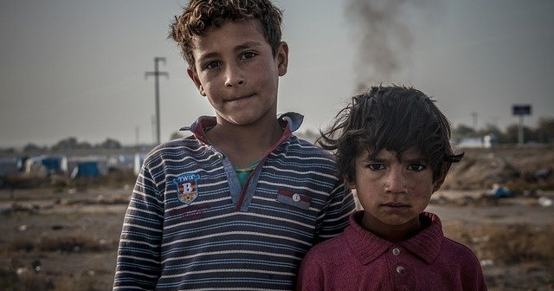
Activity 2:
Read the Article
Read the article for a better understanding of the barriers Refugees and Migrants face: https://epimonia.com/blogs/news/challenges-refugees-face

Slide 46
Challenges that Migrant Community Mediator can face

Slide 47
Funds
Space
Time
5 Main Challenges
Resources
Mutual trust
“Migrant as victim” narrative
Access to Information
Personal limits setting
These are the 5 main challenges the Migrant Community Mediator can face while doing the mediation work:
Resources – it may be challenging to find time, space and funding for some of the activities. Most mediators look for simple solutions as meeting in public and free, convenient spaces with their clients, or some of the work will include visiting institution premises. Mediation should not be an expensive process, since most of it comes down to communication. However, when activities do imply expenses, some mediators manage to seek grants and funding by turning to institutions and NGOs. Managing time efficiently is also important.

Slide 48
Funds
Space
Time
Resources
Mutual trust
“Migrant as victim” narrative
Access to Information
Personal limits setting
5 Main Challenges
Access to information is not always easy. Some countries have Citizen Information Centres, also Embassies and public bodies are good resources
Mutual trust between all parties is not always thereat the beginning
Setting personal limits is important for protecting own wellbeing
“Migrant as a victim” narrative is unfortunately very common and can be a strong demotivator for mediators to take action

Slide 49
Overcome and BECOME!
The future Modules will train you and prepare you to overcome barriers and become the Migrant Community Mediator, but here are some early hints:
Resources: plan well, make an action plan, prioritise well to best distribute available resources, find support, negotiate
Access to information: Research, network, volunteer, communicate, ask
Mutual trust: be impartial, do not let emotions overtake, plan, deliver, communicate, respect
Personal limits setting: Respect your time, it’s ok to say no, it’s ok to say I don’t know
Negative narrative about migrants is best challanged by the positive stories, start with your own positive example and be active

Slide 50
Understanding diversity, equality and inclusion

Slide 51
Understanding diversity
Diversity definition by Cambridge Dictionary: the fact of many different types of things or people being included in something
Diversity definition by Merriam-Webster: the condition of having or being composed of differing elements : variety especially : the inclusion of different types of people (such as people of different races or cultures) in a group or organization

Slide 52
Diversity of what?
- In the context of migration -
Ethnicity
Culture
Citizenship
Opinions
Politics
Heritage
Race
Preferences
Abilities
Circumstances
Reactions
Personality
Solutions
Problems

Slide 53
Understanding equality
Equality definition by Cambridge Dictionary: the right of different groups of people to have a similar social position and receive the same treatment
Equality definition by Equality and Human Rights Commission: Equality is about ensuring that every individual has an equal opportunity to make the most of their lives and talents.
It is also the belief that no one should have poorer life chances because of the way they were born, where they come from, what they believe, or whether they have a disability.
Equality recognises that historically certain groups of people with protected characteristics such as race, disability, sex and sexual orientation have experienced discrimination.

Slide 54
Activity: Me and my Identity
Worthy of equality
For this exercise you will need a pen and paper
Learning outcomes: self-awareness, valuing different perspectives, understanding how different cultures form
Instructions:
  Find one friend or a group to do this exercise with you
  Each person should draw a representation of them selves ( a person image or an object representing you)
  Each person should write down min. 5 important things for him/her. Write the more relevant things closer to the image centre, the less relevant should be further away from the centre
  Now exchange each others images

Slide 55


Me and my Identity / You and your Identity
family
security
health
love
sports
love
friendship
politics

Slide 56
Understanding inclusion
Inclusion is seen as a universal human right. The aim of inclusion is to embrace all people irrespective of race, gender, disability, medical or other need. It is about giving equal access and opportunities and getting rid of discrimination and intolerance (removal of barriers). It affects all aspects of public life.
Social inclusion is the process of improving the terms on which individuals and groups take part in society—improving the ability, opportunity, and dignity of those disadvantaged on the basis of their identity.

Slide 57
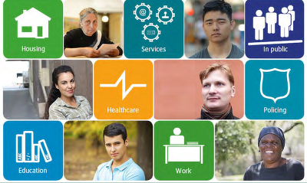

Activity
Double click on the image to navigate to the full infographic
Review the infographic https://fra.europa.eu/en/publications-and-resources/infographics/inclusion-experiences-immigrants-and-ethnic-minorities

Slide 58
Things you can do as a Migrant Community Mediator
How to practice inclusive behavior?
Listen – it’s not easy to have a voice, your role could be helping someone be heard simply by starting listening to them
Think about other peoples views – before wrapping up a conversation, give space to someone else expressing a different perspective on things. Do this by simply asking a question: “Does anyone have any other ideas or opinions? It would be great to hear them!”
Stand up for people – if you see someone being treated the wrong way
Be careful about bias – sometimes you can even have unconscious bias, keep checking your thoughts for these

Slide 59
Next Module 2: Leadership and advocacy skills in developing strong, positive and equitable communities
Community leaders take responsibility for the well-being and improvement of their communities. Migrant Community Mediators play an important role in increasingly diverse communities. In the Module 2, we introduce what it means to be a community leader and what characteristics and advocacy skills it entails. We also define strong, positive and equitable communities and show the steps to reach such results as a leader.

Slide 60
Website: www.mcmproject.eu
Facebook: @mcmproject

