Slide 1
Module 2
Leadership and Advocacy skills in developing strong, positive and equitable communities
This project has been funded with support from the European Commission. This publication [communication] reflects the views only of the author, and the Commission cannot be held responsible for any use which may be made of the information contained therein 2019-1-SE01-KA204-060535

Slide 2
Welcome to
Module 2 of the Migrant Community Mediation Course
In this , you will learn:
What is Community Leadership? Characteristics of Great Leaders in the context of migrant communities.
What are Advocacy Skills?
What is a strong, positive and equitable community? And why should we all want to live in one?
How to lead and advocate towards strong, positive, equitable communities?
How to talk to diverse groups (tips on overcoming language barriers, practising inclusive approach)

Slide 3
What is
Community Leadership?
Characteristics of Great Leaders in the context of migrant communities

Slide 4
What is Community?
Let’s expand our definition from Module 1!
The most common use of the word ‘community’ is a group that share a geographic locality and have shared interests in the quality and opportunities of that locality. It can also mean a group of people who have a shared set of values and interests.

Slide 5
A Community - Shared Set of Values and Interests
A set of shared values and interests might be created by:
employment, for example professional associations, unions, informal communities of practice
shared religious faith
people of the same ethnic background
people of the same sex and/or sexuality
interest in leisure activities: sport, music
pursuit of specific causes, e.g. climate change
child rights and gender equality

Slide 6
The way in which a community is organised to protect its own interests can be seen as a system
Understanding the Community
A community can be understood in several ways:
As a protective system
In terms of interests
In terms of power
1
2
3
For these reasons understanding community from different perspectives is an important part of sustainable problem-solving and agenda setting.

Slide 7
Understanding Empathy: Why it Matters in Local Context
When individuals have empathy, they often exhibit prosocial behaviors. For example, UNESCO’s Mahatma Gandhi Institute of Education for Peace and Sustainable Development has conducted research and research reviews showing that empathy is pivotal during peace negotiations, because neuroscience shows that empathy can “increase social understanding, lessen social conflict, limit aggression, increase compassion and caring, lessen prejudice, increase emotional competence, and motivate pro-social behavior” (Feshbach & Feshbach, 2009 in Kidd, 2015).
Community development is ultimately about enabling a positive sense of belonging in a person demonstrable through real “empathy in action” via social support.*
*SOURCE: M. Kate Berardi, Annie M. White, Dana Winters, Kaila Thorn, Mark Brennan & Pat Dolan (2020) Rebuilding communities with empathy, Local Development & Society, 1:1, 57-67, DOI: 10.1080/26883597.2020.1794761

Slide 8
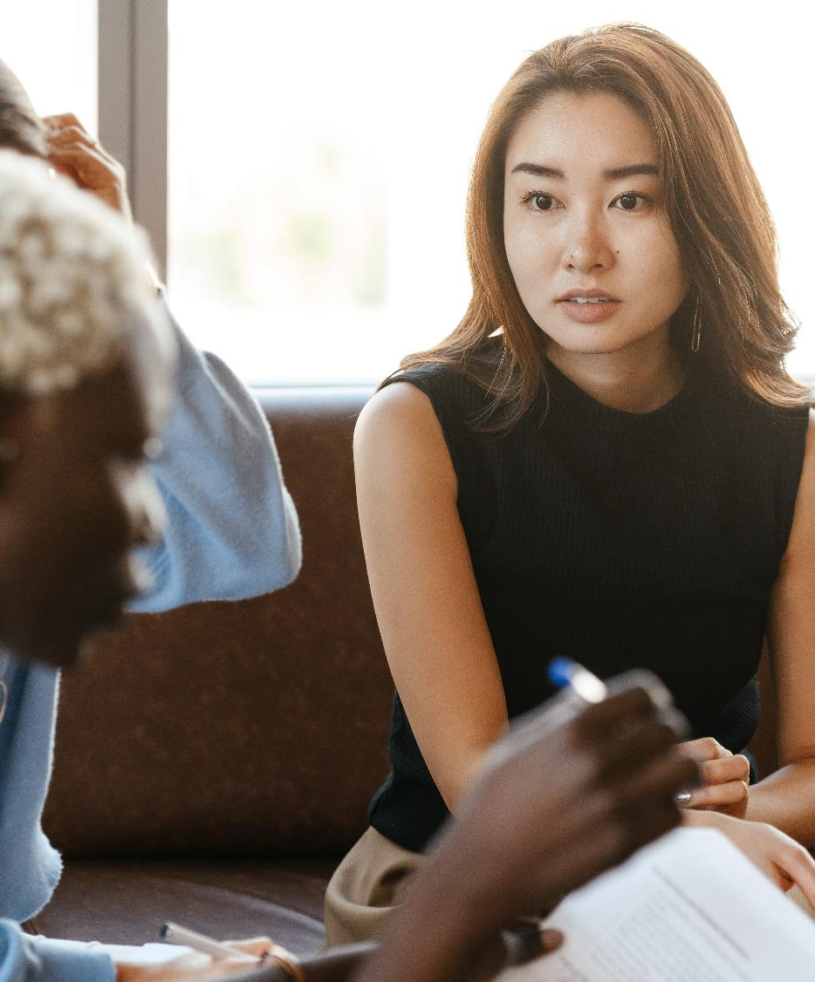
Deep listening is the kind of listening that can help relieve the suffering of another person. You can call it compassionate listening. You listen with only one purpose: to help him or her to empty his heart. ... You just listen with compassion and help him to suffer less.
- Nhat Hanh

Slide 9

Having Empathy towards all Sides in the Mediation
Try imagining and answering these quiestions
New communities' members
What are their circumstances?
Try to understand why did the come to this new community. How did that happen?
What do you think – how did they feel at different stages of their proces?
How would you feel?

Slide 10
Having Empathy towards all Sides in the Mediation
Try imagining and answering these quiestions
Host communities' members
What are their circumstances?
Try to understand what could their fear be. How did that fear develop?
What do you think – how did they feel at different stages of this proces?
How would you feel?

Slide 11
Having Empathy towards all Sides in the Mediation
Try imagining and answering these quiestions
Individuals, institutions, job seekers, employers...
What are their circumstances?
Try to understand what could their problem be. How did that problem develop?
What do you think – what are they feeling?
How would you feel?
What do they want?

Slide 12
Only once you did all the efforts to understand all involved in your mediation process, once you have considered the community, and once all involved are recieving respect, including you, the mediation can become succesfull!

Slide 13
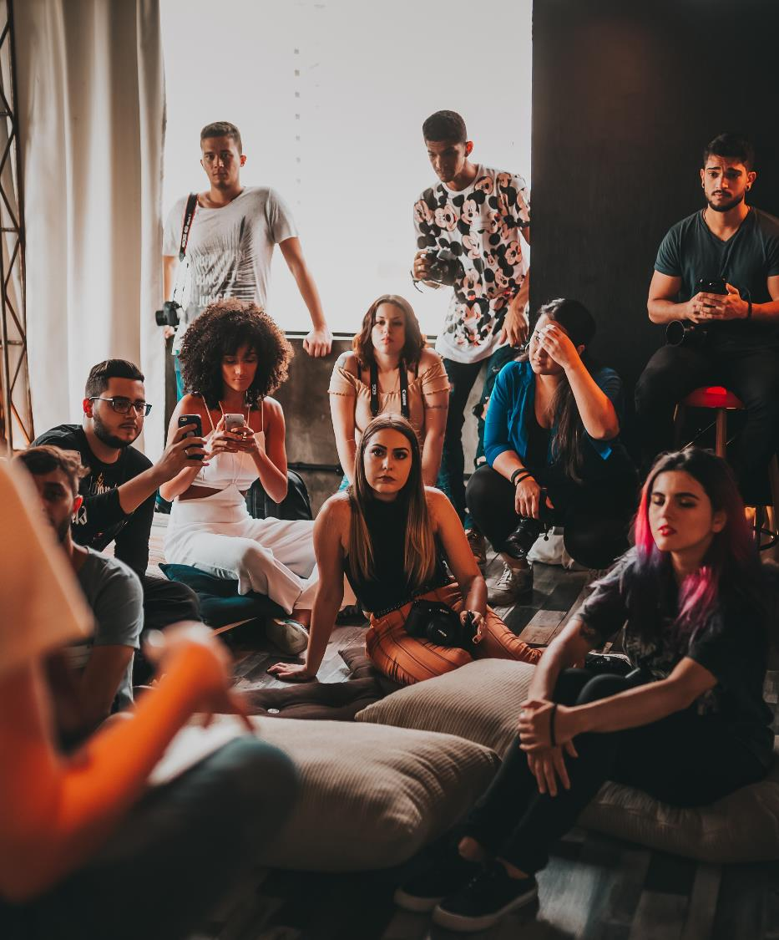
Understanding how a community perceives itself is a key part of appreciating a developing culture

Slide 14
What is Active Citizenship?
Citizens are members of an organised state or country
Citizens participate in the common life of a community
Active Citizens are those people who look beyond these basic legal duties and are further engaged voluntarily in activities that somehow affect the public life of their locality or communities
MIGRANT LEADER INSPIRATION
Inclusive citizenship means that all people can participate in decision making processes and hold others to account. Empowerment through inclusive citizenship at the local level is important for the promotion of people’s human rights and for sustainable development, but can also lead to previously excluded groups, in particular the poor, women and girls, and people with disabilities, becoming more involved in political and decision making processes at a wider, possibly regional or national level.

Slide 15

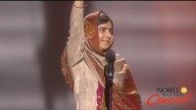
WATCH:
From an Active Citizen to Becoming a Community Leader
Learn how Malala began her fight for girls — from an education activist in Pakistan to the youngest Nobel Peace Prize laureate
READ: https://www.malala.org/malalas-story?sc=header

Slide 16

Community Leadership
Community leadership means having responsibility for the well-being and improvement of the community
Are you a community leader? Are you interested in becoming one?
MIGRANT LEADER INSPIRATION
“When the whole world is silent, even one voice becomes powerful.” - Malala Yousafzai

Slide 17
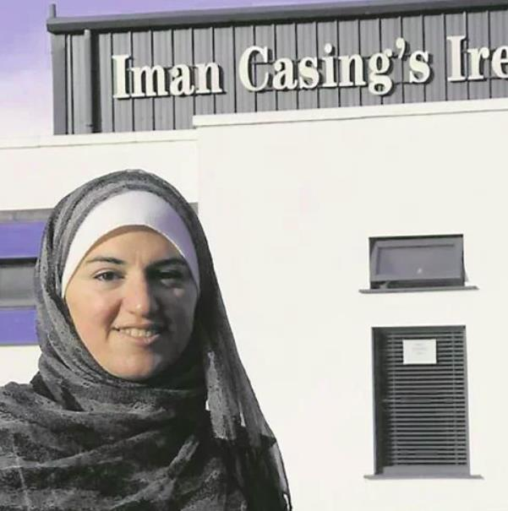
Manar Cherbatji, Ballyhaunis, Ireland
Let’s meet:
Active Citizen and Migrant Community Champion
I get involved in community groups because of my boys. I have been involved in the Family Resource Centre, the Community Council, the Defibrillator Group, and the Parents Association, in both the national and secondary school.
Myself, I think everybody should get involved because... It’s for their children, it is for themselves, it’s for Ballyhaunis, and it is for Irish people to understand the culture of different nationalities
Source: Life in Ballyhaunis, Ireland’s most culturally diverse town (irishexaminer.com

Slide 18
SELF ASSESSMENT ACTIVITY
Take a sheet of paper and start writing, try to answer these questions!
Are you someone who:
Wants to improve your community? Elaborate
Has something to contribute? Elaborate
Doesn't wait around for someone else to get the job done? Elaborate

Slide 19
Let’s get to know characteristics of good community leaders

Slide 20
Qualities of a Community Leader
To trust you, people have to know that you say what you believe and act accordingly. If people trust you, they may follow you to the ends of the earth
It's okay to shake in your boots, but someone has to go slay that dragon, and it might as well be you. Leadership means that you show others the way through the dark, scary, forest. Go ahead and speak the truth--even when it's not popular
You have to stick with a task through the good times and the bad. Your commitment will serve as a model
People will follow you if they know you care about them and about others. The greater your ability to care about all types of people, the more confidence they will have in you
Integrity
Courage
Commitment
Empathy

Slide 21
Qualities of a Community Leader
Every situation will call for a different response. Be ready to change and come up with new solutions.
Develops self awareness and gains an understanding of own needs in order to achieve happiness.
Maintains a positive attitude, builds resilience and patience in achieving own personal objectives
Demonstrates gratitude for opportunities and makes positive contributions to society. Sets an example through personal integrity, empathy, compassion and respect for others
Clearly sees what needs to be achieved, sets clear objectives for the future and aims towards progress
Creativity
Builds Self
Builds Others
Has the Vision

Slide 22
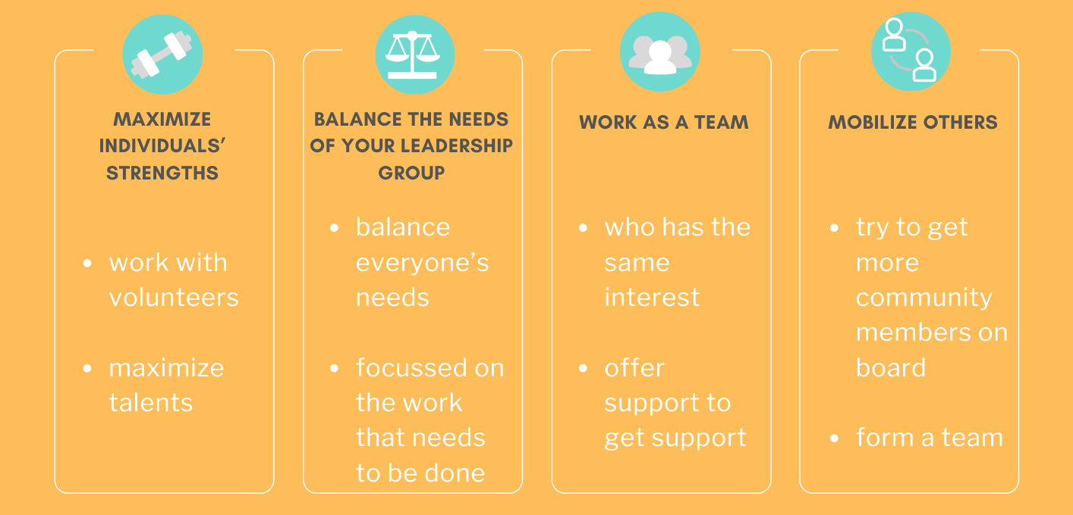
Good Habits of Successful Community Leaders

Slide 23
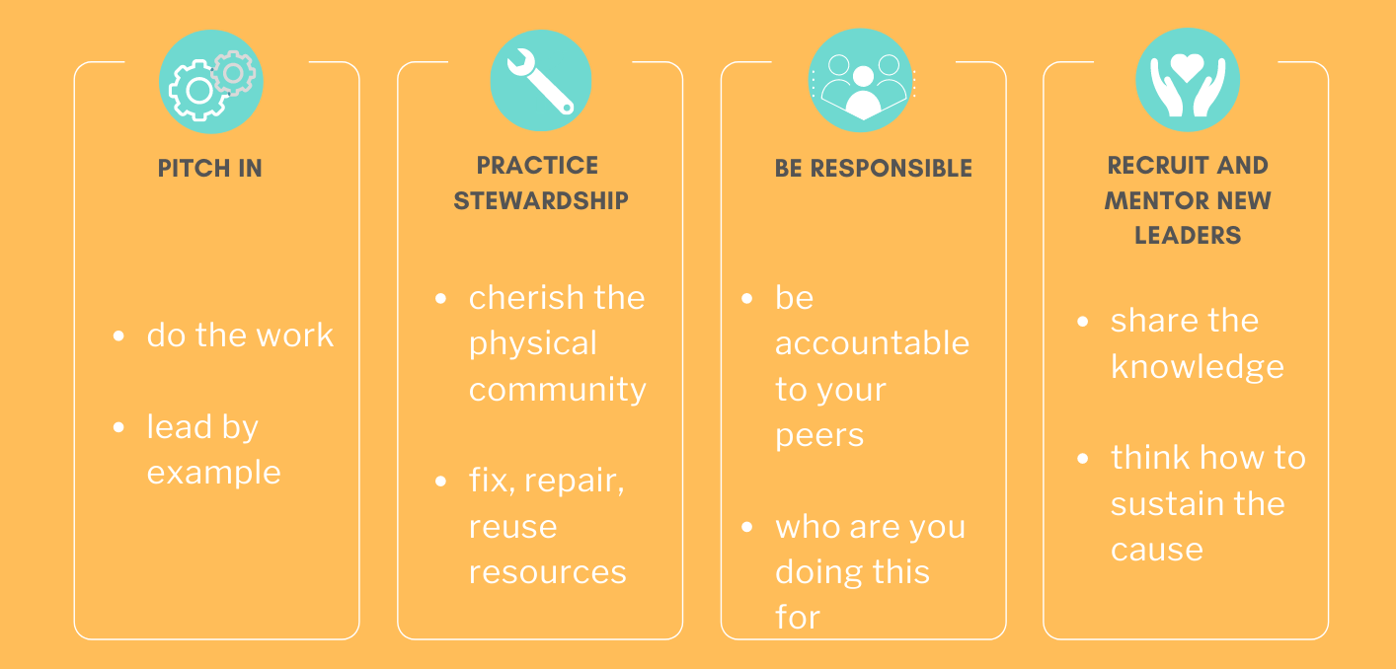
Good Habits of Successful Community Leaders

Slide 24

Decide that you are the person to take responsibility for your community
You have to make a decision to lead and view yourself as a community leader.
No one else can contribute what you can. You have a point of view that no one else has. You have a set of skills that is unique. Your corner of the world will be different if you decide to act on its behalf.

Slide 25

Do you realize how many events and choices that had to occur since the birth of the universe, leading to the making of you just exactly the way you are?
- A Wrinkle in Time (2018)

Slide 26

SELF ASSESSMENT ACTIVITY
HINT: Use this checklist to find out why you want to be a community leader:
Click HERE
Give your vision a sharper image. Turn up the focus. Set some long-term and short term goals. That is how you carve a real path to your vision.
OVERALL GOAL
What is your 3 year goal as a community leader?
How do you get there? Set 10 measurable, realistic goals – these are your SPECIFIC GOALS

Slide 27

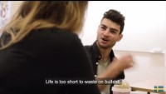
WATCH Video: Portraits of Migration
Sometimes the steps towards migrant community leadership are speaking up and introducing yourself
Film and editing: Moa Karlberg
Music: Christian Kjellvander
Copyright: Swedish Institute (SI), 2017

Slide 28
EXERCISE
Take three minutes to consider all the different communities you feel you are part of and write each one on a separate sticky note.
HINT: Remember, there are two types of communities: a community based on a geographic locality, and a community of interest
Fill in the table in the next step:

Slide 29
EXERCISE
Types of communities
 | Geographical | Interest
Local/regional
National
International/global including online

Slide 30
EXERCISE
Describe your community to details
Who is your community comprised of, what groups?
What are their demographics, their behaviour?
Is it a geographical or virtual community?
What are the problems.weaknesses of your community, what are its strengths?

Slide 31
What are
Advocacy Skills?

Slide 32
What is Advocacy?
Advocacy refers to the efforts of an individual or group to effectively communicate, convey, negotiate or assert the interests, desires, needs and rights of yourself or another person.
It can mean many things but generally = taking action!
An advocate is a person who speaks up for, and defends the rights of themselves, or of another person.

Slide 33

Types of Advocacy
Self-advocacy: taking action to represent and advance your own interests; a self-advocate is a person who speaks up for themselves, and defends their own right
Peer advocacy: taking action to represent the rights and interests of someone other than yourself
Systems/systemic advocacy: taking action to influence social, political, and economic systems to bring about change for groups of people
Formal advocacy: taking action using agencies Legal advocacy: taking action to use attorneys and the legal or administrative systems to establish or protect legal rights

Slide 34
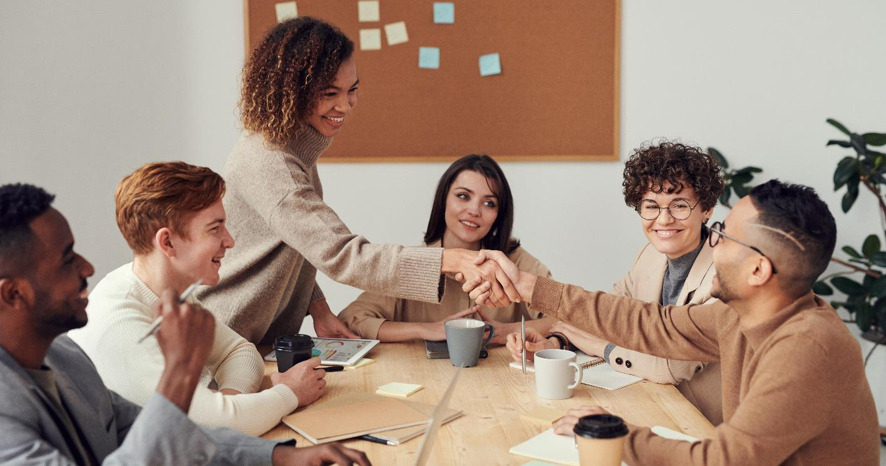
What migrant advocates bring to the table?
There is the added value that migrant advocates bring to the table!

Slide 35
The Added Value of Migrant Advocates
Knowledge and lived experience
of migration
Migrants themselves have a better understanding than anyone else of the challenges they encounter.
Due to their first-hand experience, migrants can more easily communicate with their communities and translate their needs and priorities.
LIVED
KNOWLEDGE
+
EXPERIENCE

Slide 36
The Added Value of Migrant Advocates
CHALLANGING
NEGATIVE
NARRATIVES
AND
VICTIMISATION
New perspectives
with which to challenge dominant discourses and narratives about migrants in the public and political spheres
Migrant advocates strive to showcase themselves and others as positive examples of migrants who refuse the imposed narrative of ‘migrants as victims’

Slide 37
The Added Value of Migrant Advocates
A STEP FORWARD
TOWARDS
PARTICIPATION
IN
POLICY
DESIGN
Reconnecting policymakers with the migrants
Whenever the migrant advocates are being heard, and step forward, the gap between the policies and reality becomes a bit smaller.
In reality, there needs to be more migrant participation in policy making and advocacy is a tool to get there

Slide 38
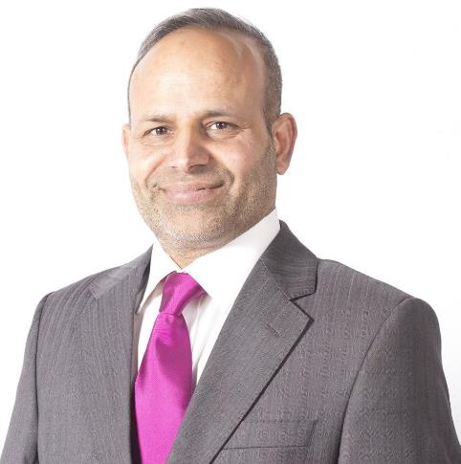
CASE STUDY
Sajjad Hussain (Pakistan Migrant) Ballaghaderreen, Ireland
Sajjad Hussain was born in Pakistan but has lived in Ireland for almost 20 years. He originally came to Ireland on a work permit and has made Roscommon his home
In 2018, he was one of four people from the Ballaghaderreen to accept a Community People of the Year award in recognition of the town’s response to the arrival of the refugees from Syria.
An active citizen in his community, Sajjad has been involved in the Tidy Towns committee, the youth organisation Foróige and he also founded the local cricket club
In 2019, Hussain contested the local Roscommon election.
Let’s meet:
Active Citizen and Migrant
Community Champion
More info: https://www.irishtimes.com/news/politics/barber-hopes-to-emerge-a-cut-above-in-roscommon-council-election-1.3797201

Slide 39
What skills are needed to be a good advocate?

Slide 40
Skills of a Good Community Advocate
Proactivity is the anticipation of circumstances and initiation of activity to take control of events rather than respond to them.
Proactive advocates think long term and, by seeing a big picture, can develop a strong vision to guide their short term plans
Listening, questioning and talking clearly and concisely. These skills play an important role in improving inter-personal communication
Making good decisions involves a broad range of skills such as analysis, research, communication and an ability to work collaboratively
Much of the work a community advocate takes place in meetings.
This includes: including skills in making presentations, facilitating group discussions, brainstorming with a group and summarizing meetings
Clear Communicator
Decisive
Meetings Management
Proactive

Slide 41
Skills of a Good Community Advocate
Required to help them overcome the individual and institutional resistance
Anticipating some level of resistance is good. The community advocate can prepare, avoid emotional reactions, plan to be persistent and plan the path
In identifying allies and mobilising colleagues to work with, it is helpful to consider the role that giving and receiving constructive feedback can play in strengthening collaborative working with allies
When advocating for something, it is very important to research the topics and sides involved, thus acquiring knowledge about the topic
Assertive
Dealing with resistance
Working together
Knowledgeable

Slide 42
Self-identify as a migrant advocate: you have many qualities needed for the role, you could simply start seeing yourself as an advocate if you are helping other migrants in any way
Ideas that will Get You Started With Advocating
Deciding to act as a migrant advocate to change the dominant narrative
Sharing personal stories as an initial step towards becoming a migrant advocate

Slide 43
EXERCISE
Understanding who decides to figure out approach and skills to develop most
‘What is power?’ Power is everywhere, knowledge, choice, influence, the ability or capacity to perform or act effectively.
Who has the power to decide in your life? Who decides in your community? Once you know who decides, you will know who you have to approach and what skills you’ll need to do so.
Fill in the table in the next step:

Slide 44
EXERCISE
Who decides?
Who can settle in – or leave – your town or city?
About education opportunities?
About safety of your community?
About representatives in the community council?
About employment rights?
About housing rights?
About benefits for families?

Slide 45

You are the stem represents advocacy. Advocacy is arguing for a particular cause, often trying to influence particular public decisions, for example policies. In this case it is advocacy that aims to get the voice of the ‘grassroots’ heard by the influencers and the centre of power.
THE POWER FLOWER
The middle of the flower is the
‘centre of power’, for example the minister of education. Who is the centre of power in your cause?
Power
Petals represent influencers on the centre of power, for example advisers, or the media. Who are influencers in your cause?
Influences
Grassroots is a commonly used word to describe the target groups of initiatives, because their needs are at the root of communities. Who are your grassroots?
Grass roots

Slide 46
What is a strong, positive and equitable community?
And why should we all want to live in one?

Slide 47
Sense of Community Has 4 Factors
Membership – the feeling of belonging
Influence – a sense of mattering. Working both ways, with members feeling like they have influence over the community and the community having influence over members. It works best with the idea of giving first before asking for anything
Fulfilment of needs – by joining the community you get something in return for your participation. It could be a support network or skills – as in volunteering
Shared emotional connection – shared history or experiences – including common causes and challenges.

Slide 48
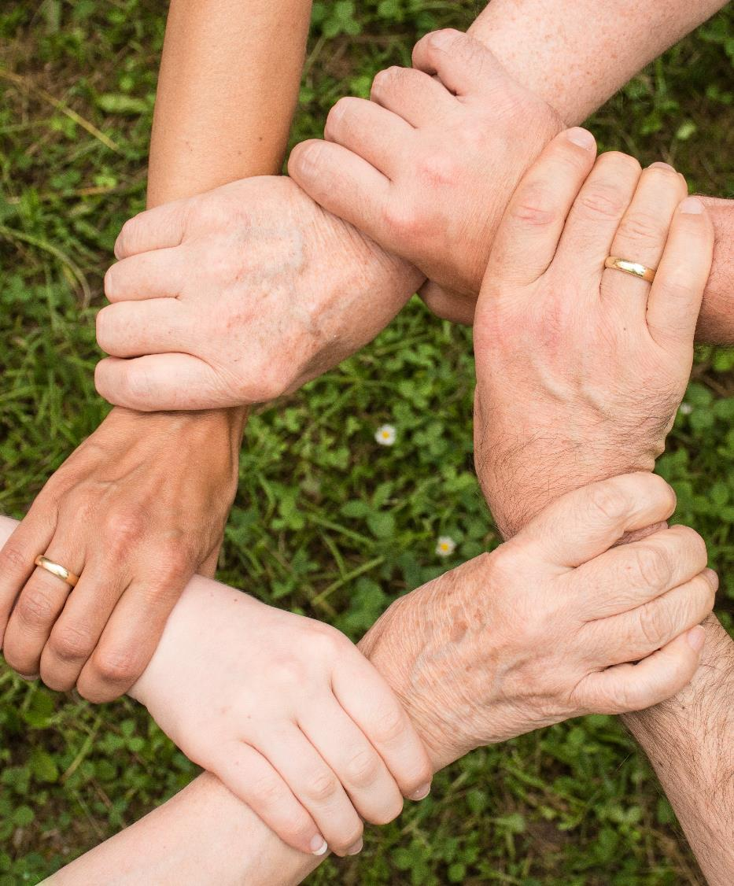
Sense of community is a feeling that members have of belonging, a feeling that members matter to one another and to the group, and a shared faith that members’ needs will be met through their commitment to be together
- McMillan, Chavis and Pretty Sense of Community Model 1986

Slide 49
EXERCISE:
COMMUNITY MAPPING ACTIVITY
Draw a map of your community
THINK ABOUT
The places with different services
Institutions and Infrastructure
Location of the places important for your community, for the grassroots,
for development, art, culture, inclusion
Use different colours to write the above words on your map

Slide 50
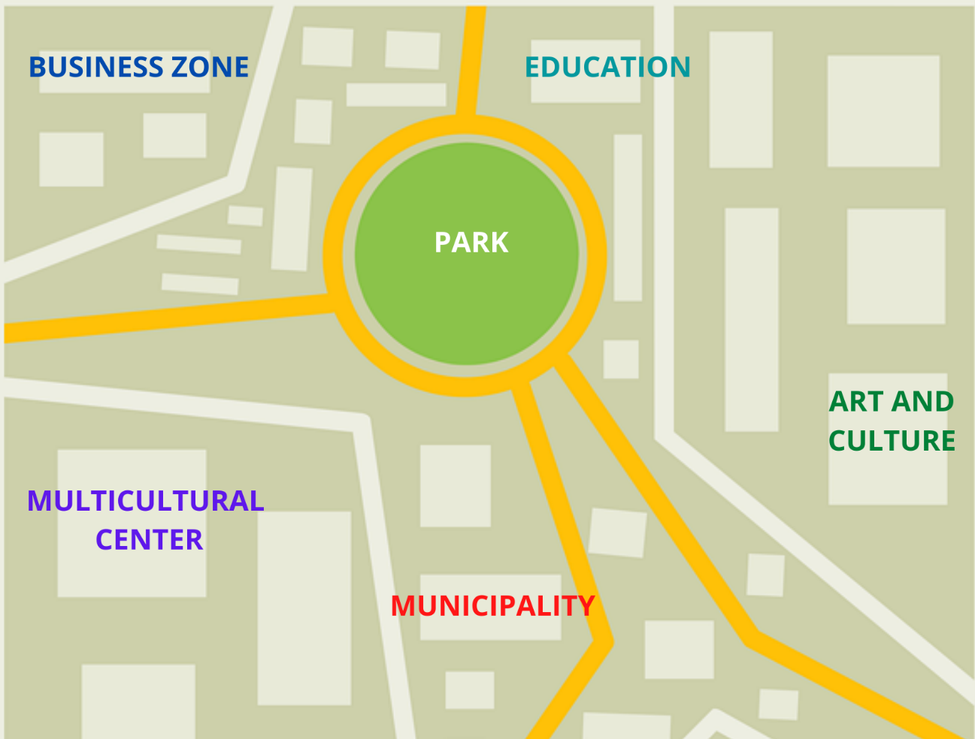
COMMUNITY MAPPING ACTIVITY

Slide 51
COMMUNITY MAPPING ACTIVITY
Now talk to the members of your community and think deeper
THINK ABOUT
What is the state of your community
In what condition are the Institutions and Infrastructure
Are you happy with your community, the conditions for the grassroots,
for development, art, culture, inclusion
Use different symbols to mark different state, opinions and feelings on your map

Slide 52
COMMUNITY MAPPING ACTIVITY
The symbols you can use to express different state, opinions and feelings on your map
Positive places
Issue or place of concern
No access
Negative places
Decision making

Slide 53
COMMUNITY MAPPING ACTIVITY
Deep analysis example

Slide 54
How to lead and advocate towards strong, positive, equitable communities?

Slide 55
Set up an
INFORMAL ADVOCACY PLAN

Slide 56
EXERCISE: INFORMAL ADVOCACY PLAN
In the previous steps you have identified issues in your community. This Informal Advocacy Plan can help you develop your action plan and to tackle the issues!
Please take a sheet of paper and write down the answers to the following questions:

Slide 57
EXERCISE: INFORMAL ADVOCACY PLAN
What is the problem or issue? If there is more than one, focus on one at a time:
What is your goal?
What facts do you know?
What additional facts or information might you need regarding this situation, such as laws, rules or policies?
How can you go about gathering this information?

Slide 58
EXERCISE: INFORMAL ADVOCACY PLAN
Who are the decision-makers that you need to influence to solve this problem/issue?
What are some possible solutions to this problem/issue (be specific)?
What are some barriers to these solutions?
MIGRANT LEADER INSPIRATION
“Without leaps of imagination or dreaming, we lose the excitement of possibilities. Dreaming, after all is a form of planning.” – Gloria Steinem

Slide 59
EXERCISE: INFORMAL ADVOCACY PLAN
Pick one solution and discuss the strategies and tactics you will use to achieve this solution. Complete the information below to assist you in initiating your action plan.
I will call/meet with/write to ______________________________ by the following date: _____________.
If this person does not resolve the situation by the following date __________, then
I will call/meet with/write to ________________________________________.

Slide 60
EXERCISE: INFORMAL ADVOCACY PLAN
Documentation that I will need: ____________________________________________
Other people who can help me: ____________________________________________
What I expect the other side to do: _________________________________________
Strategies for what’s next: ________________________________________________
Debriefing: who will I call or how will I take care of myself following this encounter?
________________________________________________________________________
What will I do if the strategy doesn’t work? What is the backup plan?
What went wrong? Why didn’t the strategy work?

Slide 61
How to talk to diverse groups?
Tips on overcoming language barriers, practising inclusive approach

Slide 62
Facilitating Intercultural Communication
Interpersonal interactions between members of different cultures constitute
intercultural communication
Our cultural identity is made up of our different experiences, norms and value systems that come into play when we interact interculturally.
There are two different models used to approach intercultural communication:
The Classic Model assumes that each person belongs to one culture.
The Model of The Multicultural Person assumes that we are all multicultural people. This means we interact in different cultures or subcultures, for example, at the football club, at the workplace, at the bank, among our family etc.
The culture and the way to interact in the football club might be different from how we interact at work or at the bank. But all cultures are part of us.

Slide 63
Facilitating Intercultural Communication
Cultural differences can lead to all sorts of misunderstandings during communication. Here are just a few examples:
How we give and receive feedback differs widely. It can be direct. Some people may be upset by direct feedback, others may not understand indirect
Making friends and acquaintances: Here too, cultures can hold different norms for entering into friendships, boundaries and situations that are suitable
How conflicts are handled and resolved can vary widely and if people are not aware of this, it often exacerbates the conflict (for example, a frank way of verbalising problems may end up offending people who are not used to this)
Decision-making: How decisions are made, and consensus is created also differs from culture to culture.

Slide 64
Practical tips for communicating in a multicultural setting
Inform yourself about the cultures of heritage of the people you communicate with
Be attentive to non-verbal communication. Write things down, use images
Communicate clearly and explicitly
Be supportive and patient
Clarity
Knowledge
Non-verbal

Slide 65
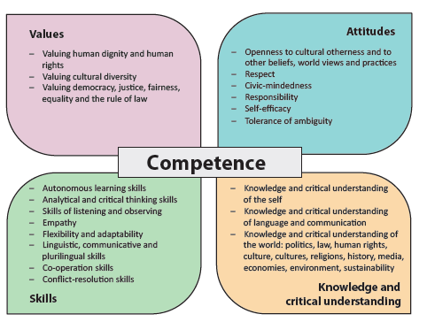
By this point in our course you have gained most of these competencies, but if you are aiming to be a perfect communicator, this overview will help you and lead your way

Slide 66
Different People Have Different Styles of Conversation
If we are not well prepared, this could mean that someone's style can lead the conversation into a state of conflict.
Situations in which conflict can occur:
where people are only interested in giving their own views, not willing to listen to others
individuals talk as if there is only one course of action
any discussion is punctuated with threatened or actual aggression/violence
questions are used to attack and undermine others
discussion and debate is used only to ‘score points’
there is no willingness or attempt to identify areas of common ground.

Slide 67
Supporting migrants in most cases means supporting them with the language.
There are two aspects to consider: language learning, and language support

Slide 68
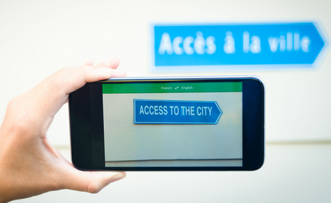
Hints and Tips for dealing with language barriers
Try to find out about any language learning offers and potential financial support schemes for your peers, i.e. the people you are mediating for
Do not put any pressure on the person trying to express themselves
Try using digital translators such as Google Translate – it even has the option to scan and translate text from a piece of paper!
Use visual material such as images and pictographs
Use gestures and facial expression as well as objects to demonstrate things

Slide 69
Migrant Community Mediator Inspiration
It’s good to remember that a person standing in front of you, trying to speak a language foreign to them, means they are exposing their vulnerable side to you.
With this motivation in mind, you are one step closer to find communication solutions powered by empathy and respect

Slide 70
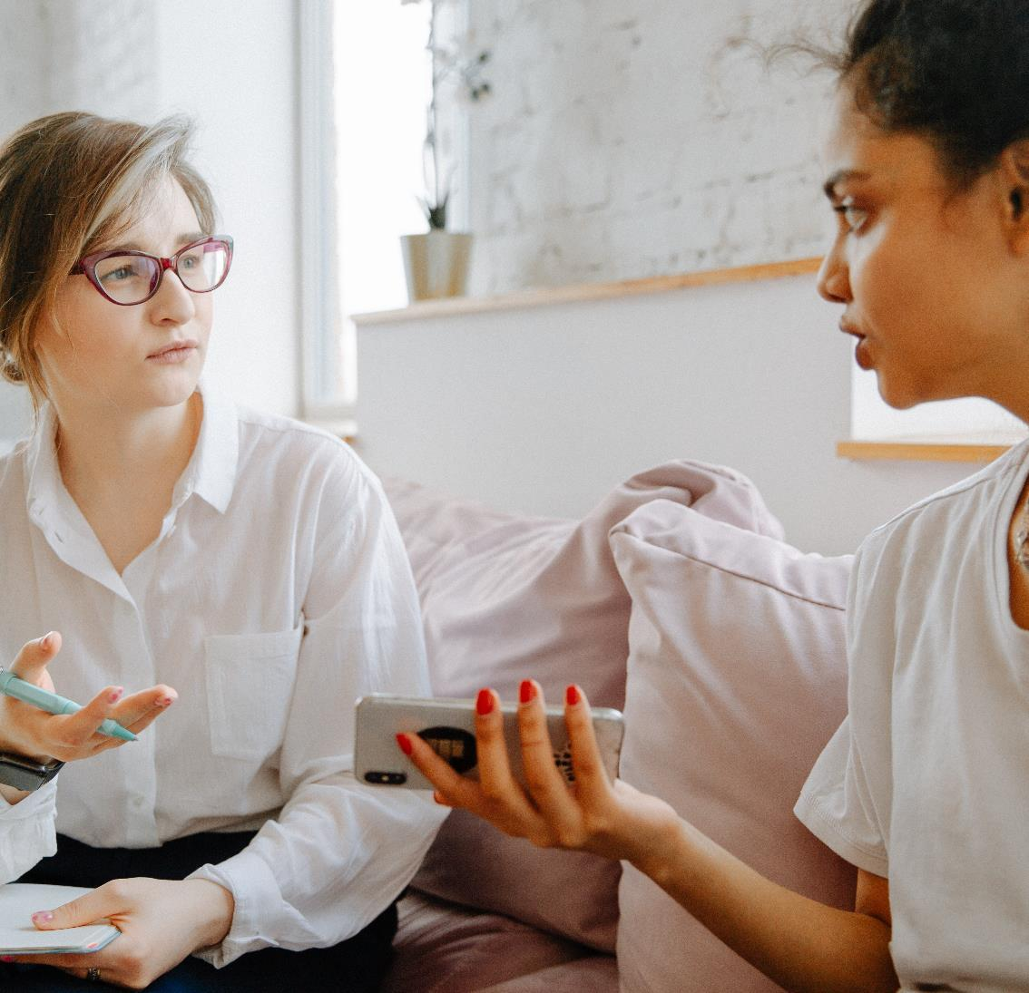
Vulnerability is not winning or losing; it’s having the courage to show up and be seen when we have no control over the outcome. Vulnerability is not weakness; it’s our greatest measure of courage.
-Brene Brown-

Slide 71

READ THE BOOK
The book: Young Children as Intercultural Mediators: Mandarin-speaking Chinese Families in Britain, click HERE
‘The book begins with giving two slice-of-life examples of how children of immigrant communities, can be mediators between their families and the new culture.
The first point that the source is trying to make, is the fact that immigrants are faced with a different culture that they are used to, and although many families express a desire to understand and live in the new culture, accessing the opportunities to do this may be restricted.
Children can help their families to accommodate to the new culture by being cultural mediators.

Slide 72
Next Module 3: Effecting change - strategies and new approaches to community mediation and active inclusion
Will show how to identify and prioritize problems in the community, and how to develop steps that lead towards positive change. Getting support from others, collaborating and understanding what barriers can come up from the host communities and institutions is all crucial for success. The theory of change can be used in it’s simplified form as an efficient tool to map out the steps toward the change.

Slide 73
Website: www.mcmproject.eu
Facebook: @mcmproject

