Slide 1
Module 3
Effecting change - strategies and new approaches to community mediation and active inclusion
This project has been funded with support from the European Commission. This publication [communication] reflects the views only of the author, and the Commission cannot be held responsible for any use which may be made of the information contained therein 2019-1-SE01-KA204-060535

Slide 2
Welcome to the
Module 3 of the Migrant Community Mediation Course
In this Module, you will learn:
Mediation in a community setting, how to identify and prioritize problems in the community and use the power of peer to peer mediation
Getting support for your Migrant Community Mediation Cause/Working with others
Understanding barriers coming from host communities and institutions
Theory of change: how to simply use it to map out the change in your community
Alternative forms of mediation (art, sports, personal branding)

Slide 3
Mediation in a Community Setting and Peer to Peer Mediation

Slide 4
Effective Mediation in the Community Setting
Effective Migrant Community Mediators represent the rights and interest of people within migrant communities
Effective mediation, of any kind, requires building a solid strategy or plan and practicing skills to help you feel comfortable and confident in reaching your mediation goals
In order to make your mediation efforts effective you should:
  1. Break down the problem
  2. Educate yourself
  3. Identify the rights involved
  4. Develop a solution (goal) and strategy to address the problem

Slide 5
But before you start...
Remember the people you are trying to help and don’t just focus on the process
Who are the people you are reaching?
How will your intervention affect them?
What are their stories?
Is there something in their circumstances that confuses you, that you do not understand?
Do you think you would have different needs, reactions, feelings if you were them?
Can you accept what they are expressing, feeling? Do you accept the differences?
Once this reflection is done, you are ready for the next steps.

Slide 6
The Tips for Effective Mediation

Slide 7

TIP 1
Collaborate with the authorities
Do not become intimidated by the authorities, learn to question responses with which you do not agree. Plan you visits, ask the questions, know the rights of your community peers, be kind and respectful, be persistent.

Slide 8

TIP 2
Offer companionship at the meetings
Sometimes migrant peers are afraid of attending any meetings alone for different reasons: language barriers, confidence, stress levels, not knowing the system. They might welcome a peer joining them, providing the fresh understanding of the situation and support

Slide 9

TIP 3
Manage information carefully
You will often need to help your peers or a community with a concrete problem. This needs a follow up with documentation to progress the issue, e.g. respond to queries via a letter/email. Retain all information carefully. Creating a paper trail means keeping a written record and evidence of the sequence of events and decisions which are important to your mediation effort.

Slide 10

TIP 4
Offer mediation (help) with phone calls
We all know how to use the telephone, but we can learn to use it more effectively as a tool for getting what we want. Lack of language skills could be a problem for your peers.Many people – understandably – lose patience when dealing with official bodies such as government agencies, financial and utility bodies. More and more, callers must navigate automated menus before reaching a live person.

Slide 11

TIP 5
In case of community mediation, share the issues of the community with the public
The age of social media allows us to quickly and easily post about issues and share information. In case of common community problem, it’s good to raise awareness, using a positive and respectful tone.

Slide 12
Let’s take a look at some mediation examples and scenarios

Slide 13

A MEDIATION EXAMPLE
Watch the video: Sparking Change, Tedx Talk
Dill Wickremasinghe has one vision and that is to create an inclusive and equal Ireland where all residents can live a fuller and more authentic life.
She is a Social Justice and Mental Health broadcaster and journalist and presents her weekly podcast “Sparking Change with Dil” on the Head Stuff Podcast Network

Slide 14

There are so many problems, but what is the PRIORITY No. 1?

Slide 15


Activity: Watch the Video
Double click arrow
The Criteria to Assess Problems Standing in a Way to an Inclusive Community

Slide 16
Finding the priority problem TO FOCUS ON
Now, when you perfected identifying the problems, and understanding them, let’s use a modern and innovative approach to PRIORITISE THEM.
The approach is called DESIGN THINKING! It helps problem solvers to understand the problem, as well as understand the people who need the solutions. It is deeply rooted in EMPATHY, and we will use the PRIORITISATION GRID based on this DESIGN THINKING method.
Now let's learn how to prioritise!

Slide 17
How to Be More Empathetic
Try Out Someone Else’s Life
Don’t just stand in someone else’s shoes, as the saying goes, but take a walk in them, said Helen Riess, a psychiatrist at Harvard Medical School and chief scientist of Empathetics, which provides empathy training for health care practitioners.
Attend someone else’s church, mosque, synagogue or other house of worship for a few weeks while they attend yours or visit a part of the community you usually don’t visit. Spend time in a new neighborhood or strike up a conversation with a homeless person in your community.
If someone’s behavior is bothersome, think about why. If it’s a teenager, for instance, start by acknowledging that he might feel stressed, but go further: Consider what it’s like to live his daily life – what his bus ride is like, how much homework he has and how much sleep he gets.
SOURCE: The New York Times, How to Be More Empathetic, By Claire Cain Miller

Slide 18
Take these empathy learnings into the next lessons about choosing a priority to work on.
To determine what impact a problem has on the community members, you will have to rely on the empathy.

Slide 19
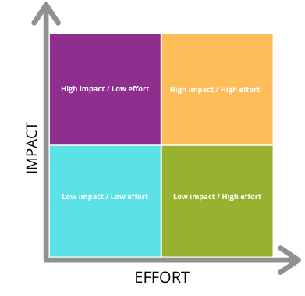
Prioritisation Grid
The prioritisation grid breaks every task into 4 possible sections:
high impact / low effort
high impact / high effort
low impact / low effort
low impact / high effort

Slide 20
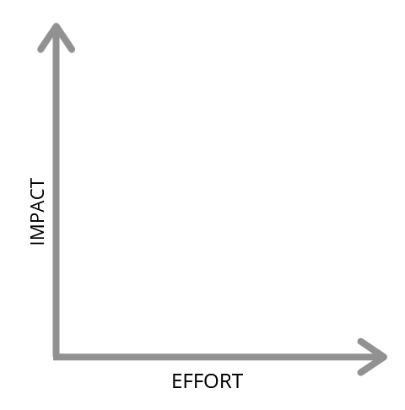
Prioritisation Grid – HOW TO USE IT?
Place all the problems you have identified on the adequate square on the grid, by asking your self:
Does this problem have high or low impact?
To solve this problem do I (do we) need high or low efforts?

Slide 21
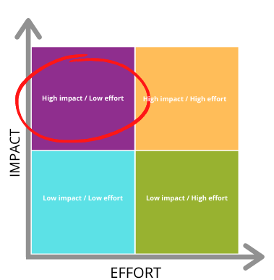
Prioritisation Grid – 1st CHOICE
Now prioritise the problems placed in the top left corner: HIGH-LOW.
This means that you are choosing to solve a problem which has the most negative influence on the community AND is also not too dificult to solve
If no problems clasified by this criteria, choose the next best thing.

Slide 22
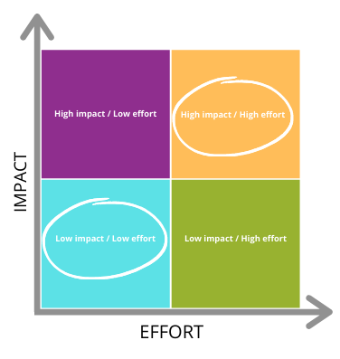
Prioritisation Grid – 2nd CHOICE
If there are no good candidates among the problems in the HIGH-LOW corner, this is the next best thing to do:
If you have time and resources to put in the effort, choose the ones in the top right, HIGH-HIGH corner. This means you will work harder but solve a BIG problem.
If you cannot afford too much effort, you mighttry to solve multiple SMALLER problems by investing a little effort. Choose the bottom left corner: LOW-LOW

Slide 23
Let’s examine some common Mediation Scenarios

Slide 24
Scenario 1: Confidentiality¹
Ivan is looking for information on what action, if any, he could take against his previous doctor whom he had seen, and who shared confidential information about him with his family without obtaining his written consent.
Pretend you are Ivan
Think about:
What additional information do you need?
Where can you get more information?
What outcome(s) do you want to achieve?
What rules govern this situation?
Who are some of the key decision-makers?
What strategies could you use to achieve the desired outcome(s)?
What barriers might you encounter/have to overcome?
¹Based on Advocacy Tool Kit Skills and Strategies for Effective Self and Peer Advocacy, Produced by Disability Rights Wisconsin, 2008

Slide 25
Scenario 1: Confidentiality¹ - continued
Possible Actions you could help Ivan with
Writing a letter to the doctor
Contacting the relevant institution regulating the breach of confidentiality
If the doctor is an employee of a clinic or hospital, Ivan could file a complaint with the hospital.
Contacting a solicitor or free legal aid to discuss options
What else might Ivan try to do in this situation?
____________________________________________________________________
____________________________________________________________________
¹Based on Advocacy Tool Kit Skills and Strategies for Effective Self and Peer Advocacy, Produced by Disability Rights Wisconsin, 2008

Slide 26
Scenario 2: Landlord/Tenant conflict¹
Maya has concerns about the fact that the windows in her first floor apartment don’t lock. She didn’t notice that the windows didn’t lock when she viewed the apartment before signing her one-year lease. She recently talked with her landlord and he promised that her windows would be replaced. Three months have gone by, no action still.
Pretend you are Maya’s peer Mediator
What additional information do you need?
Where can you get more information?
What outcome(s) does Maya want to achieve?
What rules/ordinances/laws govern this situation?
Who are some of the key decision-makers?
What strategies have you and Maya agreed you could use?
What barriers might you encounter/have to overcome?
¹Based on Advocacy Tool Kit Skills and Strategies for Effective Self and Peer Advocacy, Produced by Disability Rights Wisconsin, 2008

Slide 27



Feeling inspired?
Wondering where to look for mediation opportunities?
Migrant Community Mediation Opportunities
Word of mouth
Exchange of information among people who already have Migrant Community Mediation experiences
Social media
Using social media (e.g. Facebook groups dedicated for migrant issues) to find the right opportunity for you
Centres / organisations
Identify centres and organisations who help migrant communities

Slide 28
Getting Support for Your Migrant Community Mediation Cause/Working with Others

Slide 29
Forming Coalitions with Others
Sometimes you are not alone in having a problem with a particular agency or programme. Getting together with other people or groups can be very effective in articulating the community challenge to decision makers
However, it is important to be clear about your mission and to have as much agreement as possible among the participants
It will also be critical to have a plan of action that others agree to.

Slide 30
While forming a coalition, or after when you are mediating and advocating with your peers, you will need
NEGOTIATION SKILLS

Slide 31

Negotiation is when groups who disagree work together to resolve a problem.
All of our preparations feed into the negotiation process. As with other advocacy skills, negotiation is a skill that can be learned through study and practice

Slide 32
NEGOTIATION:
Lead with the strongest part of your argument
For example, if your peer is dissatisfied with the treatment he/she has been receiving, you might start by pointing out that a doctor or staff person has violated your state’s patients’ bill of rights.
Keep your opening explanation short by focusing on relevant facts
Often we want to tell our life story when we are trying to spur people to action. But by taking up too much of someone’s time, you run the risk of alienating that person. Instead, focus on details that are relevant to the responsibility of that person.

Slide 33
NEGOTIATION:
Focus on solutions, not complaints
Unless your goal is simply to make someone feel sympathy, then you should have an action plan for what you want to happen. For example, rather than complaining about your housing, you should state that your peer wants housing in a safer area.
Control your emotions
No matter how much the other person upsets you, don’t resort to raising your voice/becoming frustrated. If you need to, ask for a break to compose yourself. “Blowing up” during the meeting reflects poorly on you, your peer and your community, and people often use your behaviour as an excuse for denying you what you want.

Slide 34
NEGOTIATION:
Have in mind a minimum that you are willing to accept
To be a good negotiator, you should ask for more than what you really want, but keep in your own mind a minimum that you would be willing to accept.
Acknowledge the other person’s position
Demonstrate that you understand the limitations faced by the other person. This will help you keep your demand realistic and make the other person feel more comfortable in negotiating with you. For example, you might say, “I realize that the medication that I want is more expensive than other medications,” or “I know that you have a limited amount of housing available.”

Slide 35
Some More Negotiation Tips
Stick to your minimum requirements- the bottom line result that you will accept
Point out weaknesses or liabilities to the other person - Give the other person a reason to want to help you. For example, you could say, “my friend has been trying for months to get safer housing. We are fearful of the impact of his family in feeling vulnerable in their current home.”
Restate any actions decided upon - If the other person makes any promises to you, restate them as you end your meeting. Equally important, if you make promises, restate these promises as well, so that you are sure of what you need to do. Act for a follow up in writing.
Set a timeline for action - A promise to “look into the problem” or “get to it as soon as we can” doesn’t help you very much. By securing a timeline for action, you can contact the person if deadlines are not met.

Slide 36
READING ACTIVITY
By using negotiation, mediation and advocacy migrants have been able to advocate for the change of policy in Ireland.
As the result of such efforts, Minister of State Joe O'Brien has confirmed that a national anti-racist plan will be published by Government.
Read about it HERE

Slide 37
Understanding Barriers Coming from Host Communities and Institutions

Slide 38

Barriers from the lack of empathy

Slide 39
Why is lack of empathy a barrier to Migrant Community Mediation?
PsychologyToday.com defines Empathy as: the experience of understanding another person’s thoughts, feelings, and condition from their point of view, rather than from your own. You try to imagine yourself in their place in order to understand what they are feeling or experiencing.
REMEMBER – not all people nurture the gift of EMPATHY!
Unfortunately, not everyone has the trait of understanding people’s needs, especially needs of those who are new to the community, and thus their needs are new to this community
When the host community members cannot understand your pain or where your motives are coming from, they may not always be supportive and might even object your actions

Slide 40

GROUP GAME
Understanding the experience of being a refugee
The purpose of this game is to help people who have not experienced the life of a refugee, to understand this experience better. Once you complete this game with someone from your community, they should have valuable insight into what refugees go through and how they feel.
WHY A GAME?
Games are one of the best methods to help people understand phenomena which are complex and far removed from their everyday lives. A game allows participants to experience emotions in a very personal and enduring manner, but on a smaller scale than in real life.
Source: United Nations High Commissioner for Refugees, Passages UNHCR’s new educational tool, A simulation game designed to create a better understanding of the problems of refugees

Slide 41
GROUP GAME
THE GAME
The notion of time
Sit down in a place where you will not be disturbed and blindfold yourself.
Stay there for 5 minutes; do not count or use any artificial means of telling time. Use your own judgement and intuition.
Take off the blindfold and check your watch.
Think about how you felt with the blindfold on and write it down. How does it feel to sit in the dark, with no way to measure time and nothing to do but wait?
The point of this exercise: A refugee may have to spend several hours hidden in darkness, afraid of being discovered and killed. Unlike you, who have undergone this experience voluntarily, he/she is terrorized by a situation that has been forced on him/her.

Slide 42
GROUP GAME
Taking orders
Imagine that you are deprived of your autonomy. In other words, you are no longer allowed to make decisions for yourself. Your right to come and go, and to take care of your most basic needs, are all subject to someone else’s authorization (standing up, walking, going to the toilet, drinking, eating, talking, etc.).
Try to feel what it might be like to be restricted in this way. Imagine how you would react. Not only has your freedom been taken away but people are constantly giving you orders, making you work, pushing you around, interrupting you ... and no one listens to you.
The point of this exercise: To help you understand the stress that a refugee feels during his or her flight and to make you aware of the stress that your actions and attitudes may provoke among the players during the simulation game.

Slide 43
GROUP GAME
Loss
Find a quiet and comfortable place to sit. Equip yourself with a pen and paper.
Try to remember a situation when you experienced a feeling of loss. Perhaps it was a cherished object, a place you loved to visit, a favourite pet or a loved one ....
Let all the memories and emotions associated with the loss come back to you. Write them down, so that later you can reread what you were feeling and evaluate the importance of these personal experiences.
Think over your own experience of loss and consider how it must feel to be deprived of all those things or people to which or to whom you attach great importance.
The point of this exercise: Many refugees lose absolutely everything: their country, their home, their friends, their family. Try to understand the pain they must feel.
Take notes on all the above games. What did you learn, what did the player learn? Did something change in the way they understand who refugees are?

Slide 44
GROUP GAME
Shackled
Having to obey orders all the time is like being shackled. You are forced to do things without knowing why. Walk around for 2 or 3 minutes holding your right ear with your left hand and your left ankle with your right hand.
How does it feel to be forced to do this?
The point of this exercise: Think about what you have just experienced for these few minutes. Refugees live under this kind of constraint for hours, months, even years.

Slide 45

Barriers arising from lack of transparency in policy making processes and information sharing

Slide 46
The research shows¹:
in some cases, there appear to be unclear/and unstructured approaches information-sharing and cooperation between municipalities and national governments.
the lack of trust advocates feel towards policy makers also stems from the perceived lack of transparency in policymaking processes. Some research participants referred to unmet expectations or ‘empty promises’ in this context: although political parties may initially express a strong interest in collaborating with migrant advocates and migrant-led initiatives, they ultimately take no action to realise these commitments.
that although communicating with local politicians was often easier than with national political representatives, decisions are often made at national level.
*1: Migrant-led advocacy across Europe, Mohammed Badran, 2019

Slide 47

Barriers to volunteering:
Legislative barriers + lack of consideration

Slide 48
Understanding the barriers to volunteering in order to overcome them
Volunteering is an important integral part of Migrant Community Mediation, and these are the most common barriers we sometimes need to overcome in this aspect:
In some countries migrants are not allowed to volunteer, or lack insurance. In other countries, references are needed in order to become a volunteer. A migrant with a limited social network cannot always come up with the needed references
Lack of consideration and sometimes belief - by officials, voluntary organizations and agencies that promote volunteering - that migrants could be potential volunteers

Slide 49
TASK: OVERCOME THE BARRIERS
Remember the Community Mapping and the Action Plan from Module 2? Use the knowledge from the barriers section to update your Community Map and then add actions to your Action Plan to overcome these barriers, such as:
Prepare a good pitch about your problem that evokes empathy
Do the research to understand what the policy says about your problem
Find out if there is a volunteer centre that you need to partner with, and if you need to go down the FORMAL route

Slide 50
Theory of Change: How to Simply Use it to Map Out the Change in Your Community

Slide 51
What is a Theory of Change?
A methodology for planning, participation, and evaluation that is used to promote social change. Theory of Change defines long-term goals and then maps backward to identify necessary preconditions.
ARTICULATION
PLANNING
EVALUATION
DISCIPLINE
Helps organizations, programs, networks or initiatives articulate social change efforts through clarifying:
- Intentions – why are you doing what you are doing
- Expected outcomes – what do you expect will happen as a result of your actions
Shows the pathways and interventions necessary to reach intended results
For planning: lays the foundation for future activity and expected outcomes
For evaluation: articulates outcomes that will guide evaluation (but not the evaluation methods, which would be stated in an evaluation plan)
Brings discipline and alignment to practice; ensures logical coherence to an organization’s work and expected results

Slide 52
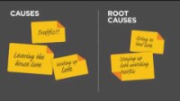
Theory of change is easier than you think:
WATCH THIS VIDEO

Slide 53
Template: Theory of Change
Problem Statement | Write the problem statement that resulted from your problem analysis.
Inputs | Activities | Outputs | Short-Term Outcomes | Mid-Term Outcomes | Long-Term Outcomes
Resources needed to conduct your activities efficiently. Examples: Human resources Space/Facilities Technology Materials Curriculum Etc. | Activities needed to reach your outcomes. Examples: Workshops Trainings Learning activities Services Policy advocacy Delivery of products Etc. | Tangible results you produce through your activities. Examples: # of targeted beneficiaries # attendants % of completion % increase in learning outcomes etc. | Outcomes expected of your intervention(s). Changes in: Learning Awareness Knowledge Attitudes Skills Opinions Aspirations Motivations | Outcomes you want to see in your intervention timeframe. Changes in: Actions Behaviours Practices Decisions Policies Social actions | Outcomes you hope to observe beyond your intervention timeframe. Changes in: Conditions Social contexts Environmental characteristics
ULTIMATE Impact | Write the impact that you achieve through your intervention(s)

Slide 54
Let’s break down the steps to start using the Theory of Change today and bring change to your community

Slide 55

Plan your process (what is the PROBLEM, how much time, new or old initiative?)
Collect evidence of need and context (evidence of need)
Determine your intended impact (the ultimate resolution, for example: reduction in migrant unemployment in the local area)
Articulate your long-term outcomes
(Example: In order to reduce unemployment, migrants will need to: get sustainable jobs, employers will have to increase migrant uptake)

Slide 56

Map your intermediate outcomes backwards (work backwards and plot the preceding stages in much greater detail. Example:
To achieve our long-term outcome ‘migrants get sustainable jobs’, this needs to happen:
migrants increase their job-specific skills
empoyers’ awareness about the issue increased
employers create equal opportunities
Identify outputs (products, services or facilities that will help you to bring about the outcomes you have identified)
Clarify assumptions (the conditions that need to be in place to make the theory work; they explain the logic behind the overall programme and behind the causal links (for example, showing that an output will lead to an outcome, or that one outcome will lead to another) in the theory.)

Slide 57

Establish timelines and plan resources
Produce your diagram and narrative (As you develop your theory of change you will need to make it available in a useful format. Most people find a diagram or map helpful. Here you can find information about some of the software options for creating one: https://www.inspiringimpact.org/resource-library/the-best-software-to-create-a-theory-of-change/
Get ready to use your theory of change (Now you’ve created your theory of change, don’t forget to use it. A theory can help you to plan your project or feed into your organisation’s strategy. It can also help you to communicate succinctly about your work and the change it makes.)

Slide 58
Alternative Forms of Mediation (Art, Sports, Volunteering, Personal Branding)

Slide 59
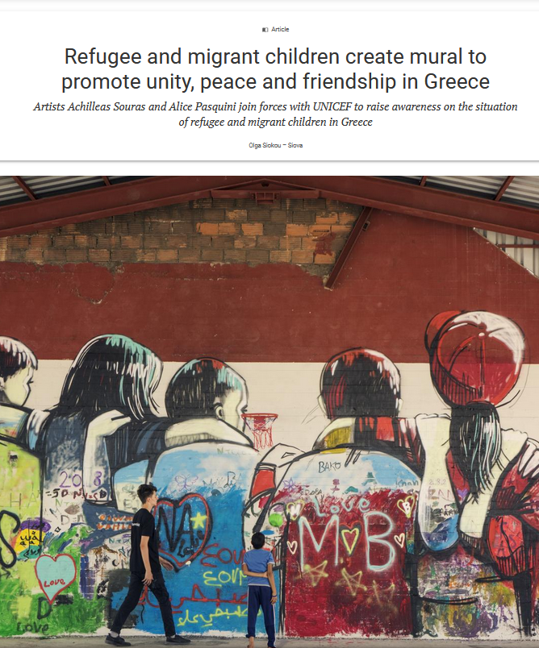

Double click and read
„Mediation is another word for FRIENDSHIP.
Migrant Community Mediators provide friendship though many different forms.”
- Migrant Community Mediators project team

Slide 60

The art has spoken. On the following slide we bring you an article that talks about how works of art can provide an alternative critical way of thinking on migration, besides the discourse in which European democracy has become entangled.
There is also a link to Gianfranco Rosi’s film Fuocoammare, as an example of how strong mediation through art can be!

Slide 61




Double Click to read
&
watch a film
Art can highlight the particular and sensorial reality that is normally lost in our conceptualised understanding
Watch Fuocoammare (Fire at sea) online: https://couchpop.com/film/fuocoammare-fire-at-sea/

Slide 62
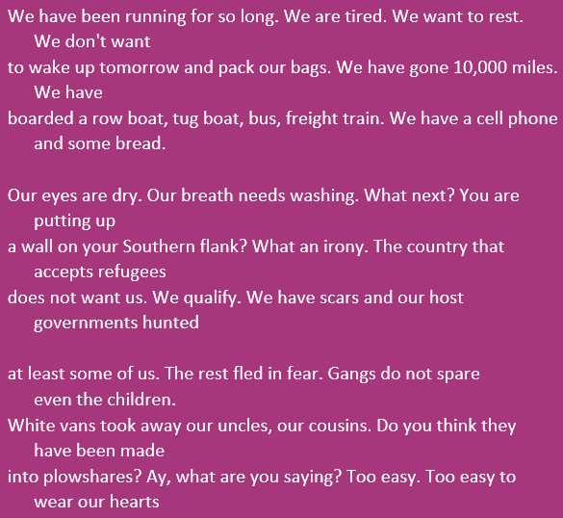
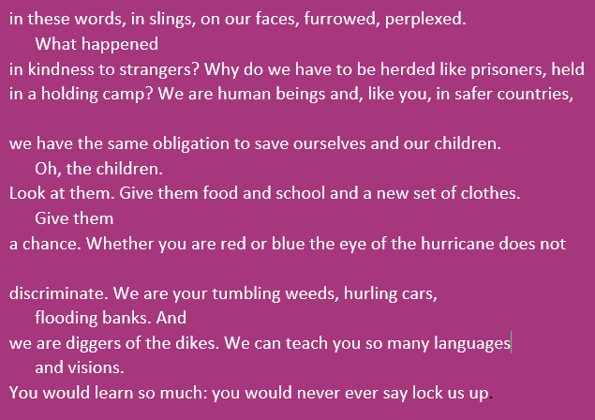
Mediation through poetry!
The Migrant's Reply
By Indran Amirthanayagam
Indran Amirthanayagam, "The Migrant’s Reply" from The Migrant States. Copyright © 2020 by Indran Amirthanayagam. Reprinted by permission of Hanging Loose Press.
Source: The Migrant States (Hanging Loose Press, 2020)

Slide 63
Example of Mediation through Creating a Movement
New Women Connectors is an initiative led by migrant and refugee women who have mobilised themselves in becoming a collective movement, demonstrating what the strength of unity and the power of raising one’s voice can do. Their aim is to raise awareness about the challenges and opportunities refugee and migrant women face in Europe, through facilitated platforms of discussion, thus creating a shift in communities and policy at large.
https://www.newwomenconnectors.com

Slide 64


Example - Techfugees:
Empowering displaced people with technology
Techfugees is an impact driven global organisation nurturing a sustainable ecosystem of tech solutions supporting the inclusion of displaced people.
https://techfugees.com/

Slide 65

Watch this video to learn about:
mediation through food and volunteering
Find out more about Ellie Kisyombe – from volunteer community lead projects, to elections, click HERE

Slide 66



Want to volunteer?
Start off well
You need to COMMUNICATE your voluneering aims, look for host organisations and keep in touch with them
Each organization has its own rules that every volunteer must follow. You need to agree on what your COMMITMENT is, and do your best to stick to that
FOCUS: Volunteering can be a great experience for sharing cultures, tradition, learning the language, developing new skills and meeting people from all over the world

Slide 67
Migrant Community Mediation through SPORTS
Get Inspired resources:
How Senior World Medalist Nzingha Prescod Advocates For Diversity and Inclusion In Fencing: https://baucemag.com/nzingha-prescod-advocates-for-diversity-and-inclusion-in-usa-fencing/
The British Asian Rugby Association (BARA) is a dual code, inclusive, UK not-for-proﬁt NGO of ten years standing. It has a history of campaigning for equality and inclusion for Asian communities (not exclusively) in rugby, and has delivered tangible projects which break down cultural and religious barriers and provide sporting beneﬁts to a much under- represented minority ethnic community: https://sportsbanter.com.au/british-asian-rugby-association-bara/

Slide 68
Get inspired
Official statics say that “at least” 86% of Rosengärd (a city district in the center of Malmö Municipality, Sweden) residents were of foreign origin, the unemployment rate up to 60% and that 71% of the children were living in relative poverty. School results were among the worst in the country and the crime rate, one of the highest.
This is where, to migrant parents from Bosnia, a boy was born in 1981. His name is Zlatan Ibrahimovic. Facing dificult circumstances in his childhood, the boy grew up to become one of the biggest foodbal players of all time, overcoming many obstacles and becoming a role model, especially for many young people with a migrant background.

Slide 69

Watch the video:
The trailer for the the documentary "Ibrahimovic - from Rosengård more than one goal”
“Nobody believed I could do it. Everybody was trash‑talking. They thought I will go away because I have a big mouth. They thought this guy’s vision is crazy. It will not happen. But I had these dreams of where I would end up. And now here I am.”, Zlatan Ibrahimovic, for the Guardian

Slide 70
Next Module 4: Communications and media practices - tools and skills to become an informed voice in media debates and in policy development and resources planning
In Module 4, we share learning on how the Migrant Community Mediator can choose the message and manner in which the message will be communicated to the public. We explain what Policies are, to emphasize what the importance of aligning with policies is, so that the Migrant Community Mediator can effectively succeed at his/her mediation goals, by aligning his actions with policies or by proposing changes to the policies. Next, we show what kind of tools of communication with the public exist and we give examples to inspire

Slide 71
Website: www.mcmproject.eu
Facebook: @mcmproject

