Slide 1
Module 4
Communications and media practices - tools and skills to become an informed voice
This project has been funded with support from the European Commission. This publication [communication] reflects the views only of the author, and the Commission cannot be held responsible for any use which may be made of the information contained therein 2019-1-SE01-KA204-060535

Slide 2
Welcome to the
Module 4 of the Migrant Community Mediation Course
In this Module, you will learn:
How the Migrant Community Mediator can choose the message and the manner by which the message can be communicated
We explain what Policies are, the importance of aligning your work with policies so that you, as a Migrant Community Mediator, can effectively achieve your mediation goals
Finally, we highlight the most effective communication tools and we give examples to inspire.

Slide 3
Crafting an effective mediator’s message

Slide 4
Let’s remember the goals
In MODULE 2, you completed a SELF ANALYSIS EXERCISE and a COMMUNITY MAPPING ACTIVITY. So you now you have an idea of what you would like to achieve. In the same module you also developed an ADVOCACY PLAN.
In MODULE 3 you had an opportunity to FORM YOUR GOALS and think about how to BRING CHANGE.
Now, it’s time to choose and shape YOUR MESSAGE.

Slide 5
CRAFTING AN EFFECTIVE MEDIATOR’S MESSAGE
in 6 steps
Open with a statement that engages your audience. Make a statement that gets your audience’s attention right away, perhaps using a dramatic fact. This is your lead-in and should be only a sentence or two.
Present the problem. Describe the problem, who it affects, it impacts
Provide facts about the problem. Data is important to demonstrate that a problem exists and to support your position. Look for facts that are relevant to your audience.
STEP 1
STEP 3
STEP 2

Slide 6
CRAFTING AN EFFECTIVE MEDIATOR’S MESSAGE
in 6 steps
Share a story or give an example of the problem. An example or story puts a human face on the issue and makes it real and more compelling. Again, make sure the example is relevant to your audience
Connect the issue to the audience’s values, concerns or self-interest. Show your audience how this interest fits with what they care about, want or need
Make your request
(the “ask”). Clearly state what you want the person to do.
STEP 4
STEP 6
STEP 5

Slide 7

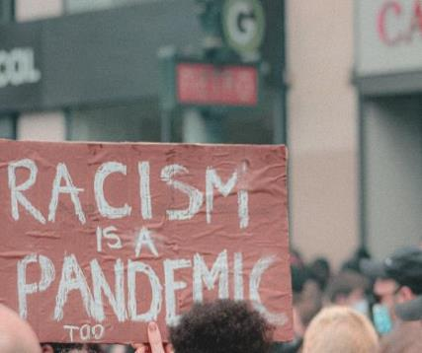



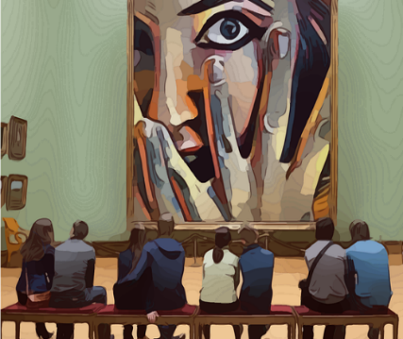
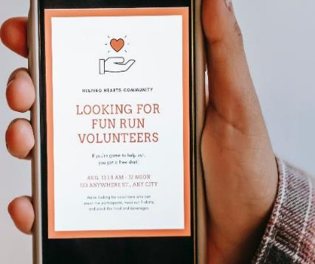
LET’S VISUALISE: CLICK ON EACH IMAGE to follow the link to the MESSAGE
ENGAGE
PRESENT THE PROBLEM
FACTS
CTRL + CLICK on each image to see the example
TELL THE STORY
CONNECT WITH THE AUDIENCE
ASK

Slide 8

Importance of voice and tone of voice
One way we write empowering content is by being aware of our voice and our tone.
What’s the difference between voice and tone? Think of it this way: You have the same voice all the time, but your tone changes. You might use one tone when you're out to dinner with your closest friends, and a different tone when you're in a meeting with your boss.
Your tone also changes depending on the emotional state of the person you’re addressing. You wouldn’t want to use the same tone of voice with someone who’s scared or upset as you would with someone who’s laughing.

Slide 9
VOICE - try these:
Be plainspoken: walk in your audiences' shoes, what do you want them to hear? Clarity perhaps?
Be genuine: passionate, real, accesible, human, not perfect
Be hopeful: show that you expect everything to turn out positively, that gives room for progress
Ballance seriousness with humour: we need both to be listened to and unedesrtood

Slide 10
TONE - try these:
Voice stays the same, tone changes depending on the listener
FORMAL VS CASUAL
SERIOUS VS FUNNY
RESPECTFUL VS IRREVERENT
ENTHUSIASTIC VS MATTER OF FACT

Slide 11
EXERCISE
Write down all the characteristics of your voice and tone of voice you would use to communicate your Migrant Community Mediator messages to the public:
__________________________________________________________________________________________________________________________________________________________________________________________________________________________________________________________________________________________________________________________________________________________________________________________________________________________________________________________________________________________________________

Slide 12

TASK: Communicating social action¹
Imagine being in an evaluator/lift with an influential decision maker for one minute and sharing information about your social action.
Now imagine that you are in your community, and you have just entered the lift wearing a T-shirt that says, ‘Active Citizens’. A influential decision maker steps into the lift and asks you ‘What is Active Citizens?’
You have 2 minutes to answer. What do you say?
Source: Active Citizens facilitator’s toolkit, BRITISH COUNCIL

Slide 13
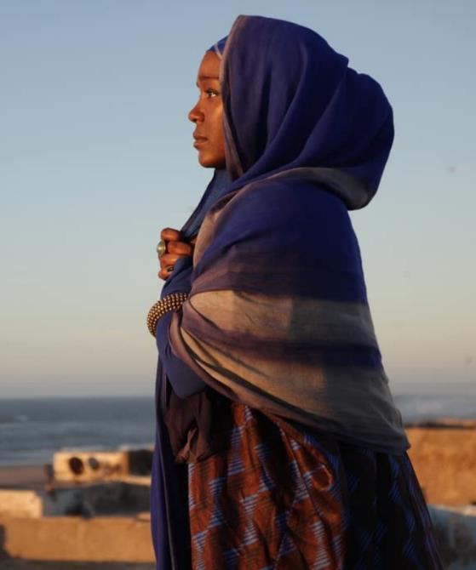

Watch a film: A Girl from Mogadishu
Based on the testimony of Ifrah Ahmed, who - having made the extraordinary journey to escape war-torn Somalia - emerged as one of the world's foremost international activists against Gender Based Violence and Female Genital Mutilation.
Double Click on the image
for more information
about the film

Slide 14
Double click on the image
Read an Article:
Mary McGuckian, the Irish Director of the film explains „Throughout the whole process we had, everyone kept asking, how do you make a film about Female Genital Mutilation? Because as well, this was all pre-#MeToo.
From the point-of-view of a drama, you approach it from, first, character and then from the point of a cinematic thesis. Ifrah herself is so compelling – charismatic, funny, beautiful – and talking to her and understanding her story, it became clear that was the thesis – she uses her personal experience and testimony as her campaign tool. “So ultimately, the film’s story is a simple one: It’s about what happens when women stand up and speak their truth”.

Slide 15
REFLECT
What was the message of the Girl from Mogadishu?
What media was used to talk about the message?
What if the story about this was not told, if there were just facts about it available in the media? Would the message have been as strong?
Write down 5 things you have now learned from this example, about forming your message! (you don’t have to make a film ☺ )

Slide 16
What is Policy?
National Policies, EU policies, how does your message link to them?

Slide 17
WHAT IS POLICY?
Policy is the set of values and objectives that guide the work of organisations and bodies. This includes, for example, National Government policies and the European Union policies.
Policy is important because it tells us what organisations and bodies plan to achieve and how they will be guided in their work.

Slide 18
Take Government policy for example:
Government policy tells us what the Government’s priorities are and what it plans to accomplish.
It sets out the commitments it is making on a range of different issues. For example: education and training, employment, mental health, the rights of people with disabilities, migration and so forth.

Slide 19
How does your message link to policies?
The messages and activities that take place as part of migrants’ rights advocacy can help to achieve national inclusion and integration policy objectives. For example:
Policies should support initiatives that promote active citizenship of migrants
Your message can connect migrants and decision makers to ensure that migrants have a voice in decision-making that affects their lives
Your messages could feed into the needs analysis for any migrant inclusion and integration strategies as well as general developemnt strategies at local, national and international levels

Slide 20

Some Examples of policies
The Migrant Integration Strategy (Ireland, national level + local levels – each county needs to have one)
Published on the 7th of February, 2017 sets out the Government’s approach to the issue of migrant integration for the period from 2017 to 2020: http://www.integration.ie/en/isec/pages/migrant_integration_strategy
CLICK TO READ

Slide 21
Top tip:
Try not to be intimidated by authority!
Learn to question responses with which you do not agree.
This will have an affect on the way you form your message: whichwill become more authentic and hold more value!

Slide 22
Events, an effective engagement tool

Slide 23
In-person Events, a powerful engagement tool
If you need to share information with the public, an event is a powerful method. Be clear on
What is the purpose or goal of the event? Purpose or goal should always drive your choice of tool.
How many attendees are you expecting?
Do you want audience to interact with one another to share information and ideas, or just to recieve the messages
How much time and/or other resources do you have to prepare for the event? All in-person events require time and planning. Typically, more time and resources are required to plan and implement tools that involve more intensive interaction among stakeholders.
SOURCE: https://www.epa.gov/international-cooperation/public-participation-guide-tools-inform-public

Slide 24


Types of events
Tool | # of Participants | Best Suited for
Public Meetings | Limited by room size. | Smaller communities and communitise where stakeholders are willing to attend meetings.
Briefings | Generally designed for smaller groups. | Reaching out to established groups.

Slide 25
Public meetings bring diverse groups of stakeholders together for a specific purpose. Public meetings are held to engage a wide audience in information sharing and discussion. They can be used to increase awareness of an issue or proposal, and can be a starting point for, or an ongoing means of engaging, further public involvement. When done well, they help build a feeling of community.
Public Meeting
Advantages
Introduces a project or issue to a community
Provides all participants a chance to voice their concerns, issues, and ideas
Disseminates detailed information and decisions throughout the community
Provides opportunities for exploring alternative strategies and building consensus
Can create consensus for action on complex issues that require broad-based community input

Slide 26

PUBLIC MEETINGS: Principles for Successful Planning
Click on the illustration to read the full list of principles and resources needed to organise a sucessful public meeting.
Public Participation Guide: View and Print Versions, click on the illustration below

Slide 27
PUBLIC MEETINGS: Principles for Successful Planning
Click on the illustration to read the full list of principles and resources needed to organise a sucessful group briefing.
„Assertiveness is the most important communication skill you can exhibit in the team briefing; it is essential to openness.”
- David Marshall

Slide 28
Briefings
Briefings are generally short presentations provided directly to community groups at their existing meetings or locations – such as social and civic clubs – to provide an overview or update on a project.
Advantages
Informs stakeholders of an innitiative and provides them with a chance to ask questions
Keeps key stakeholder groups informed and involved in a less formal and expensive process than large public meetings
Can be held more frequently than larger public meetings
Generally used with existing groups who hold meetings
Are informal and help to build community good will and create a more effective atmosphere for dialogue and responding to specific questions

Slide 29
How to move your meetings and events to online space?
The Covid-19 pandemic has forced us to move many meetings, events, conferences and exhibitions to online space. Here is how to do it succesfully:
Develop the outcome and format: Agree on the desired outcome of the event and thereby scale it accordingly. Would three smaller conversations over Microsoft Teams help you connect stakeholders and brainstorm ideas, or would a livestream conversation over Facebook or a webinar, that is also recorded, engage a bigger audience?
Design the identity: Develop the visual identity of the event: logo, colors, images, mesages – remember Canva! In high competition with other events, it is important that the event stands out with a clear and aligned identity across social media platforms.
Secure speakers: Find the right speakers who are powerful performers, have deep expertise and are, perhaps, the unheard voices on the topic.
Curate content: Work with the speakers to curate their content in a powerful format. If the aim is to have a panel, interview each panellist and ensure they know what the others will speak about to have a powerful conversation.
Secure participants: Map who should be invited, handle the invitation process and ensure registrations to the event. Calendar invitations should be sent in advance as well as a reminder on the same day.

Slide 30
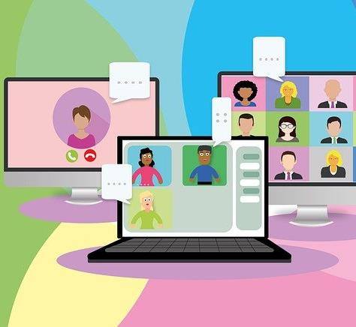
Develop a landing page: A landing page for the event should be designed and programmed to register participants, and perhaps live stream content. Consider www.eventbrite.com
Market the event: If you want your event to reach as many people as possible, market it as an event on LinkedIn, across social media channels with short videos, teasers and illustrations, and on your website.
Keep events short: To keep people’s attention, keynotes should be kept to a maximum of 12 minutes, panels to 30 minutes with ample time for questions.
Record the event: Whichever platform you use, it’s possible to record the event so you later can make it available. Remember asking for consent!
Follow up: The participants should get a follow up email with materials mentioned during the talk, a link to the recording so that they can share it with their network, and an invitation to join the community moving forward.

Slide 31
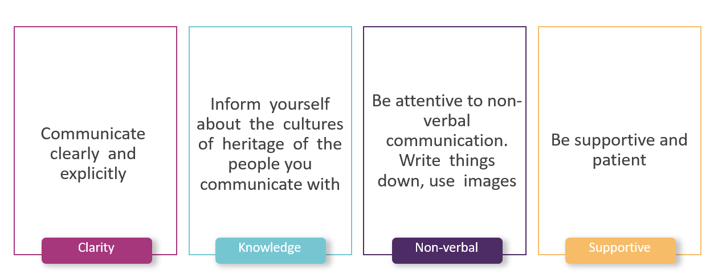
How to use these tools to communicate to diverse groups?
Remember this from module 2?

Slide 32
The most effective communication tools
Website
Printed information
Press and media

Slide 33

1. Website
As and individual, an advocate, or as a member of a group, you can choose to communicate your messages through a website.
Website enables you to get your message heard, build a community of supporters and influence policy

Slide 34

6 Ways Your Website Can Be a Tool for Advocacy*
1. Provide links to important resources
A potential supporter learns about your organisation and mission and searches for your website to find out more. As soon as they enter your site, they should have easy access to all important resources. This should include all of the content related to your advocacy efforts.
If your organisation takes a strong stance on an issue, it’s crucial that your website has an easily navigable menu with links to top pages that are dedicated to:
Your organisation’s position regarding the issue and actions you’ve taken in the past or plan to take
Other reputable sources like government pages and official legislation
What the visitor can do to help
*SOURCE: www.grassrootsunwired.com

Slide 35
2. Showcase any upcoming advocacy events
Advocacy events are influential and long-lasting. their effectiveness is due to both your supporters’ passionate actions as well as the publicity and awareness raised when this type of event is marketed and conducted.
To ensure that potential supporters and advocates are aware of all of these opportunities, you need a dedicated space on your website to showcase all upcoming advocacy events. embed an interactive calendar that users can click through to explore what’s available and sign up to participate themselves.

Slide 36



3. Include a supporter or membership programme
This is usually for your larger stakeholders and more passionate supporters and allows them to play a larger role in your management and campaign planning. This has potential to grow into a fundraising campaign to support your advocacy and mediation goals.
If yourinitiative wants to expand its advocacy efforts, you might want to develop a dedicated membership programme for it. This allows your most inspired and willing supporters to take a more active role with your community.

Slide 37

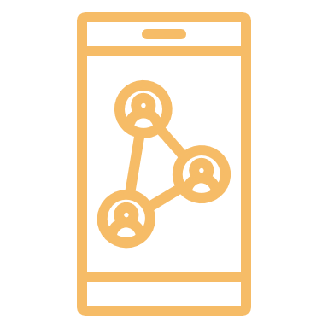
4. Display connections to your social media accounts
Some of the best advocacy efforts happen on social media. This is because social networks can easily spread the word about key issues and expand your reach exponentially. One supporter will tell all their contacts, and many of these people will tell contacts, and so on.
For your website to support your social media advocacy campaign, you need to clearly advertise and display all of your social media connections. These can simply be icon buttons that send users to the relevant account.

Slide 38

5. Write blog content
Start writing blog posts to keep your website content very fresh with opinion pieces on the topics and issues that you are advocating for:
Informative news articles
Inspiring stories relating to the issue
Recent accomplishments
Interviews with other advocates about their efforts
Prioritize transparency

Slide 39

A POWERFUL BLOG EXAMPLE
“We Are People Too”: A blog by Chris McDonagh on growing up as an Irish Traveller
Chris McDonagh is a Campaigns Officer at Friends, Families and Travellers and also run @TravellersAgainstRacism.
CLICK TO READ
Chris is an Irish Traveller and grew up travelling around the United Kingdom. He writes on his personal experiences of growing up within the Travelling community, both good and bad.to the Romanian state .

Slide 40
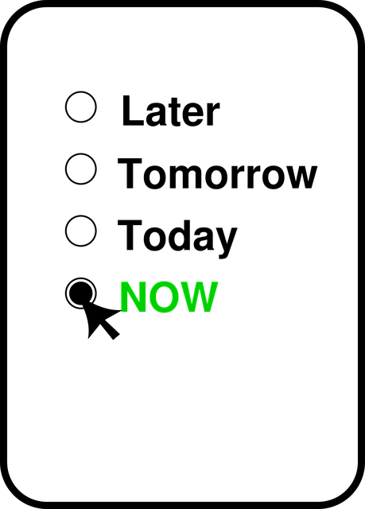
6. Make sure that supporters know how to take action
To ensure your website supports this task, your users and audience need to know how they can take action. Incorporate calls-to-action (CTAs) throughout your website that encourage visitors to the target task:
Signing up for an advocacy event
Emailing a key decision maker
Signing a petition
Posting on social media with a hashtag
Volunteering for an event

Slide 41

TOP TIP #1
Try WORDPRESS to build your web site, watch this short tutorial to get some orientation

Slide 42

TOP TIP #2
Try WIX to build your web site, watch this short tutorial to get some orientation

Slide 43

TOP TIP #3
Try SQUARESPACE to build your web site, watch this short tutorial to get some orientation

Slide 44
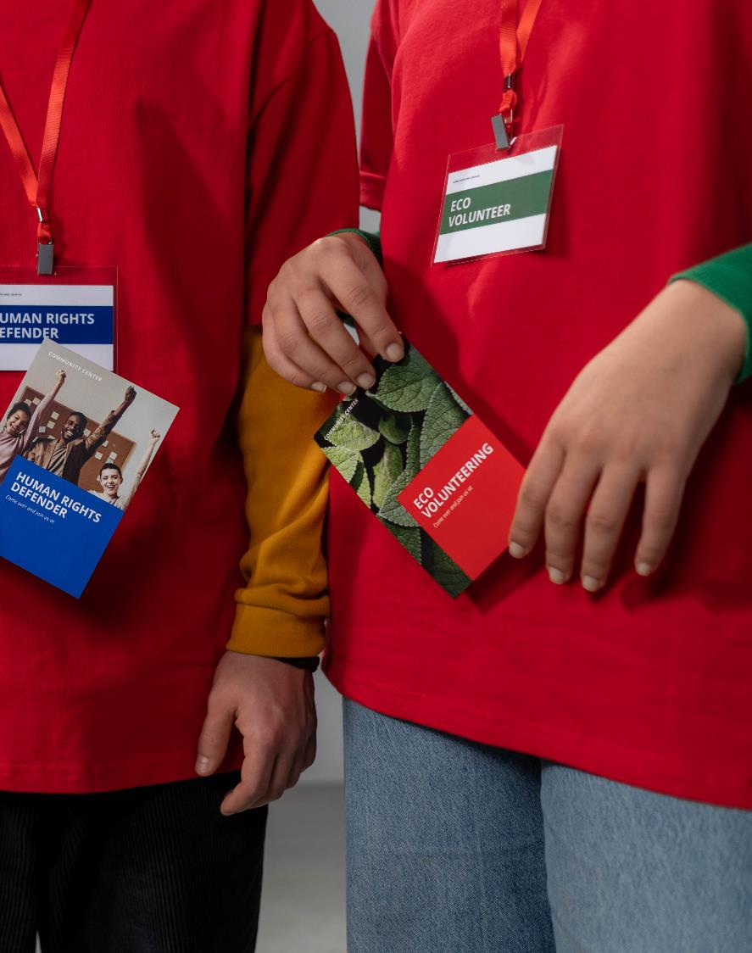
2. Printed information
Despite all the available digital channels, print products look and feel better if done the right way
Flyer
A flyer is used to publicize messages. A professionally designed flyer contributes to the success of a project. That means more visibility, more awareness, and more engagement.
Poster
A poster can draw attention in many places. It is a great way to make the public aware of certain problems, ideas, or information.

Slide 45
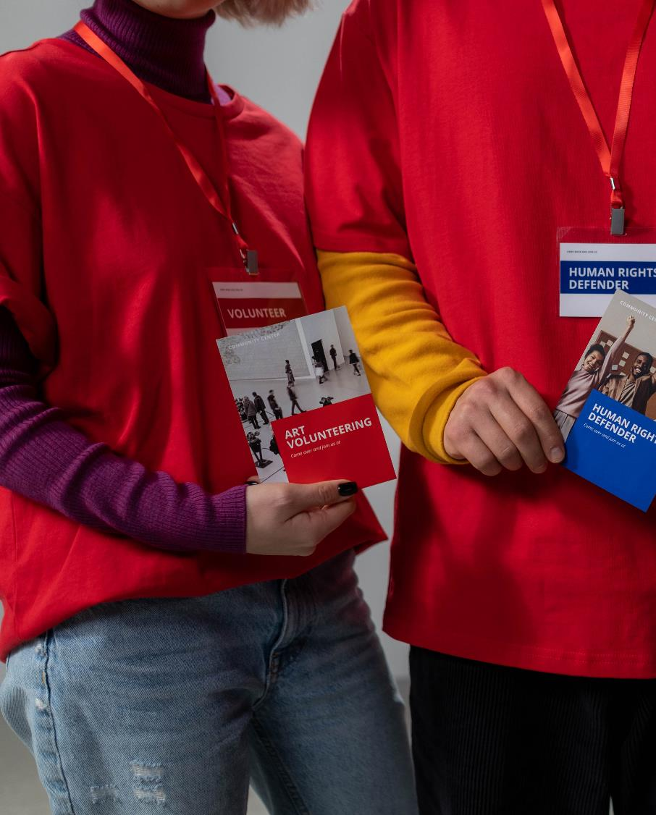
Printed information
Despite all the available digital channels, print products look and feel better if done the right way
Newsletter
Do you provide your stakeholders with periodic information? Many people still prefer reading comprehensive information in print.
Booklet or Brochure
Brochures provide a first overview of important information. They have to strike the perfect balance of information depth and handiness.

Slide 46

TOP TIP: Use Canva to prepare your prints!
Canva is a really simple tool you can use for producing your printables. It is a powerful tool for visual storytelling and can be easily customized with a choice of fonts, backgrounds, frames and more.
Watch the video to find out more about it!

Slide 47
3. Press and media
We chose the 3 powerful tools to get press and media involved
1. Podcasts
offer the potential to bring widespread public attention to your message
2. Press release
is a written announcement
circulated widely to media outlets that can bring public attention to your campaign
3. Social media
include internet-based
communications channels, like Facebook, Twitter and Instagram, to engage your target audiences and inspire them to take action to support your campaign

Slide 48

What is a podcast?
Simply put: a podcast is an audio programme, you subscribe to it and listen to it whenever you like.
How do they work and how do you listen to them, though? ead on to find out!
In a little more detail, a podcast is a series of spoken word, audio episodes, all focused on a particular topic or theme, like cycling or startups. You can subscribe to the show with an app on your phone and listen to episodes whenever you like on your headphones, in the car or through speakers.
The most convenient way to listen to a podcast, long term, is through your smartphone.Follow the link to find out about Best Podcasts Apps for the Ultimate Listening Experience: https://www.thepodcasthost.com/listening/best-podcast-apps-smartphone/

Slide 49

Activity: Understand the power of podcasting
Pick and choose one of the podcast from the Absolutely Intercultural podcast series - https://www.absolutely-intercultural.com/
CLICK
TO start choosing the podcat

Slide 50


2. Press release: When to Use It?
Strategic timing is important for press releases as for press conferences.
Press releases are most effective if they have a “hook” to a timely event. Do not send too many of them!
DOUBLE CLICK on the image to FIND OUT: How to Create a Press Release
A well written press release follows a common structure and includes a number of important elements that will make it most useful for journalists.

Slide 51

3. Using social media to push your message

Slide 52
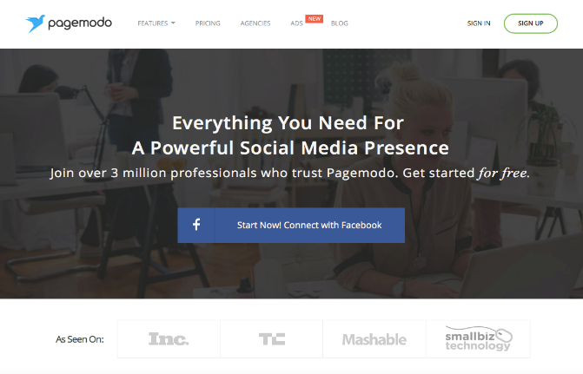
Facebook
Facebook is still the most popular social media website. It is a great resource in communicating your mediation/advocacy message.
Live video streaming is becoming a popular method for causes to reach out to their audience
Free Facebook Timeline Cover Maker Tool - www.pagemodo.com is a great FREE tool for creating interesting and engaging Facebook Cover images
CLICK TO VIEW
Experiment With How Often You Post. It very much depends on your cause & audience.

Slide 53
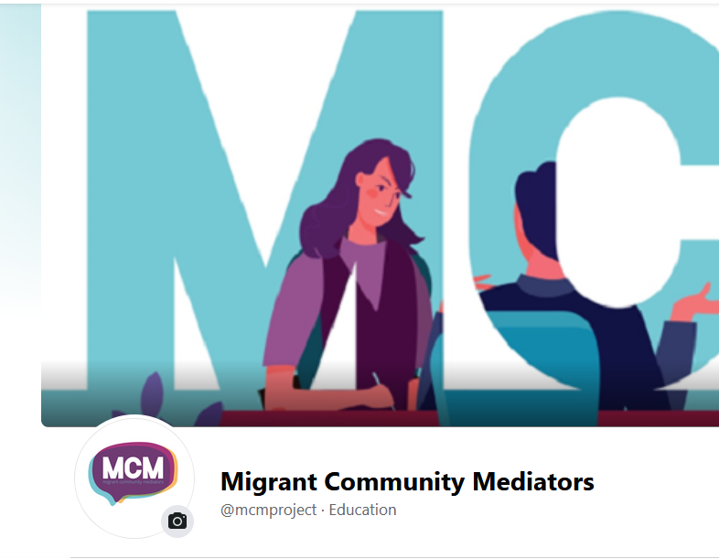
Facebook Page: Migrant Community Mediators
Migrant Community Mediators project has its dedicated Facebook page
It is a good example of mediation communication through Facebook
Please like the page and feel free to contribute via comments and shares
CLICK TO VIEW

Slide 54


Instagram
Instagram is a powerful platform for creating visual content and engaging your key audience
It is said to be 15 times more powerful than Facebook.
A major bonus is that Instagram has some amazing easy to use photo editing tools and filters that make your photos look very professional and attractive!
CLICK TO VIEW
Power of Video - Instagram videos should be short and sweet

Slide 55
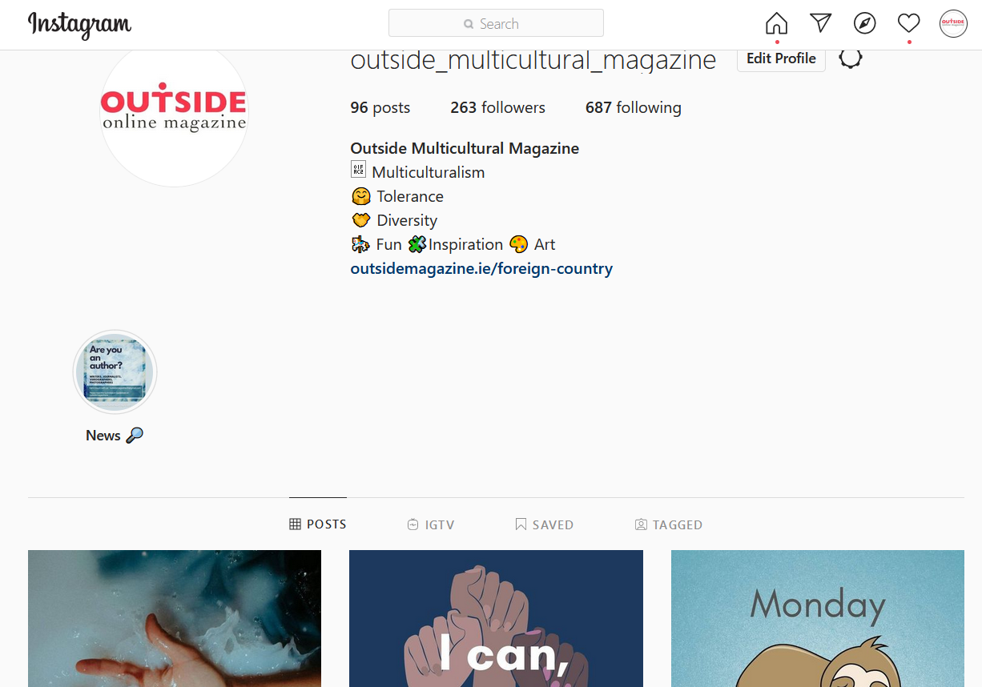
Instagram Account: Outside Multicultural Magazine
Outside Multicultural Magazine gives voice to new communities
They fight the negative narrative by communicating positive facts about diversity and inlcusion
You can follow their account and exchange ideas and feedback
CLICK TO VIEW

Slide 56

Twitter
Twitter is a fantastic tool which gives you the potential of reach far outside your normal circle. It is excellent way of reaching media, policy makers etc.
#
A hashtag will make your content more accessible and viewable by anyone in an interest in the topic.
?
Can you think of a good hashtag for your new message?
CLICK TO FOLLOW

Slide 57

Twitter account: Immigrant Council
The Immigrant Council of Ireland is a national, independent non-governmental organisation that promotes the rights of migrants
It would be a good idea to follow as many similar accounts as possible, engage with them and follow their lead in communicating via Twitter
CLICK TO VIEW

Slide 58

Do not feel stressed and pressured to get into the media!
CLICK TO get INSPIRED
Remember, you are a mediator even if you help one person!

Slide 59
Innovative ways to inform
The Power of Art
Performance as a way to spread the message

Slide 60

1. The power of art in intercultural mediation
Art and Intercultural Dialogue Festivals, exhibitions, drama, literature or film are among the most powerful ways at people’s disposal for them to express their worldviews, emotions and opinions.
Art is the most used instrument (and through the most varied forms), for remembrance and celebration of important events, for preserving collective identities, for honouring people.
Through art, individuals and groups also actively exert citizenship and propagate opinions: they claim rights, denounce atrocities, influence public opinion and encourage action of their peers.
Art is used to educate youngsters, to animate groups, to stimulate solidarity and collective links and to foster community wellbeing, or solely to touch the inner world of spirituality and worship, delight and ecstasy.*
*SOURCE: Art and Intercultural Dialogue, COMPARATIVE AND INTERNATIONAL EDUCATION: A Diversity of Voices, Allan PitmanUniversity of Western Ontario, CanadaMiguel A. PereyraUniversity of Granada, Spain

Slide 61
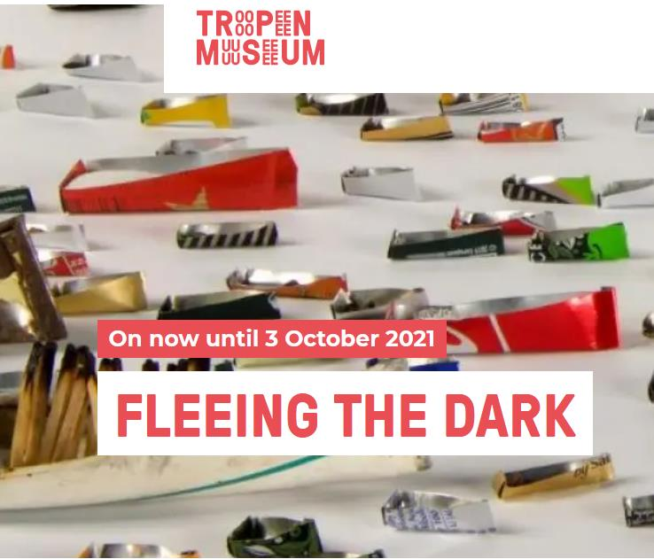
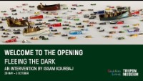
Play the video:
Fleeing the Dark exhibtion
The Dutch National Museum of World Cultures has invited Syrian-born artist Issam Kourbaj to curate an intervention in the Tropenmuseum Lichthal, where he combines his own artworks with objects from the collection that inspire him. The intervention marks ten years since the start of the crisis in Syria. Thousands of miniature boats, a rare 16th century Herbarium and more form Fleeing the Dark, an exhibition about migration, growth and hope.

Slide 62

2. Performance as a way to spread the message
Performance includes plays, dances, puppetry, poetry, song, and other formats that provide information relevant to important pending decisions, opportunities to participate in the decision process, and/or the importance of public participation. Performance tools use story-telling as the basis for creating and communicating information.
Unlike many conventional public participation tools, performance often involves an affective or emotional dimension to information sharing. As such, it communicates by appealing to intuition and feelings rather than by strict logical persuasion. Performance is often effective in that it brings information directly into the community, it entertains as it communicates, and often engages people directly in the process.

Slide 63
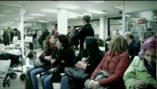
Activity:
FLASH MOB Watch video
At a time when Spain is enduring unemployment at 26%, Carne Cruda 2.0, a programme on the Spanish Cadena SER network, sent a small orchestra to flash mob the waiting room of a busy Madrid unemployment office.
Their touching performance of The Beatles ‘Here Comes The Sun’ instantly went viral across the globe and brought international attention to Spain’s growing economic crisis.
SOURCE: https://www.youtube.com/watch?v=kS709ZyZ_YU&feature=youtu.be

Slide 64
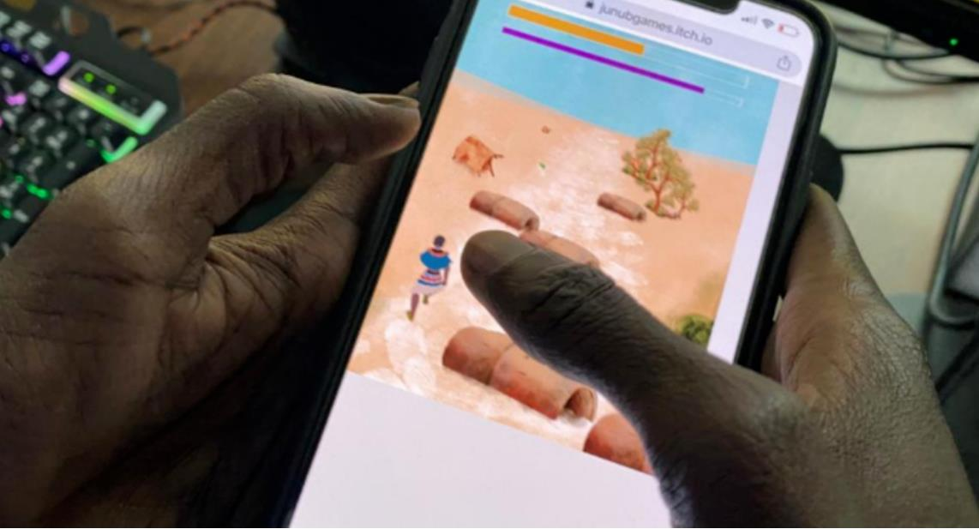
Double Click on the Image to Read:
This video game lets you step inside the shoes of a refugee
CLICK TO get INSPIRED
The goal of Lual Mayen’s video game is to survive the horrific ordeal of a refugee, an experience that his family knows well, but the 25-year-old developer’s ambition is to change the world.

Slide 65

Lual Mayen, a video game creator who had a refugee experience in his life
"Salaam," which means "peace„, a game that’s actually a message of peace

Slide 66
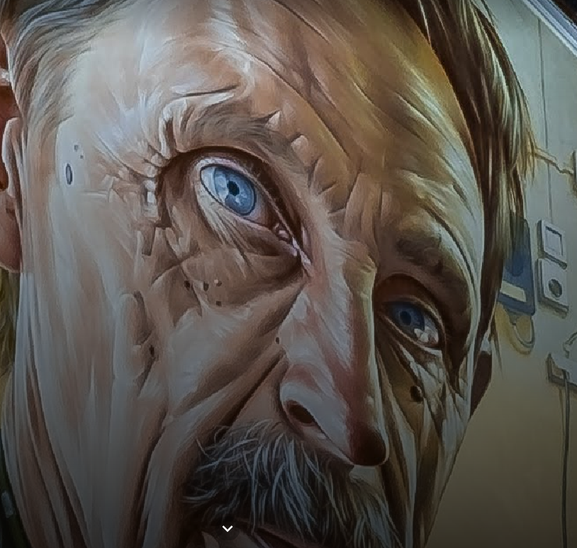
Messaging involves using mechanisms to reach people “where they are.”
A GOOGLE STORY:
A Social Inclusion through Street Art Partnership
Raising awareness about marginalised groups with photorealist murals in Stavanger, Norway.
CLICK TO get INSPIRED

Slide 67
Next Module 5: Resource models - levering public and community investments, attracting resources
Sourcing funding is crucial for most of the community initiatives. In Module 5 we show what exact steps are to succeed at funding sourcing, from internal analysis to, identifying funding opportunities and engaging community in the process.

Slide 68
Website: www.mcmproject.eu
Facebook: @mcmproject

