Slide 1
Module 5
Resource models - levering public and community investments, attracting resources
This project has been funded with support from the European Commission. This publication [communication] reflects the views only of the author, and the Commission cannot be held responsible for any use which may be made of the information contained therein 2019-1-SE01-KA204-060535

Slide 2
Welcome to
Module 5 of the Migrant Community Mediation Course
In this , you will learn about:
Getting ready for funding, self-analysis, identifying needs and resources needed
Identifying institutions and opportunities that can provide funding and resources, understanding their rules
Identifying partners and stakeholders
Applying for funding, fundraising
Volunteers and community engagement in using the resources

Slide 3
Getting ready for funding, self-analysis, identifying needs and resources needed

Slide 4

Success Recipe in Securing Funding
It really is like making a cake
It depends on ingredients
(you and your project)
& following a recipe (the fund giver’s objectives and rules)

Slide 5

Pros and Cons of Funding
THE CHALLENGES
Plenty of funding programmes, but deep research needed to find out which best fits your needs
Can be difficult to administer
Insecurity of the results
You could become overdependant on just one funding source
Need to tailor projects to suit funding programmes
And then there is Covid-19
THE PROS
There is a positive movement in funding available for new communities, inclusion and equality across EU

Slide 6




Before you start, focus on your priorities. Leave aside the priorities of possible funders and the fears of not being fit for funding.
The Pesimist Says
The Optimist Says
MIGRANT COMMUNITY MEDIATOR Says
The LEGEND:
External opportunities
Funding available for inclusion initiatives
„Let’s talk about the benefits of ice”
Migrant Community Mediator’s PRIORITIES
½ empty of funding opportunities
½ full of funding opportunities

Slide 7
SELF ASSESSMENT ACTIVITY
Try to answer these questions to get clarity on what you want to achieve through funding.
What are your priorities for next 1 – 3 years? 3 – 5 years?
Survival or growth? New opportunities?
Would you change anything about your goal as a mediator?
Same activities?
Same modes of operation? Any remote working or digitisation changes etc.?

Slide 8
Activity: Do a SWOT analysis for your mediation project
SWOT
Internal
Strengths
Weaknesses
Human resources
Physical resources
Financial resources
Activities and processes
Past experiences
What are your own advantages, in terms of people, physical resources, finances?
What do you do well? What activities or processes have met with success?
What could be improved in your mediation project in terms of volunteers, staffing, physical resources, funding?
What activities and processes lack effectiveness or are poorly done?
External
Opportunities
Threats
Future trends
Funding sources (foundations, donors, legislatures)
Demographics
The physical environment
Legislation
Local, national, or international events
What possibilities exist to support or help your effort , the people you serve, or the people who conduct your work?
What local, national, or international trends draw interest to your programme?
Is a social change or demographic pattern favorable to your goal?
Is a new funding source available?
Have changes in policies made something easier?
Do changes in technology hold new promise?
What obstacles do you face that hinder the effort - in the environment, the people you serve, or the people who conduct your work?
What local, national, or international trends favor interest in other or competing programmes?
Is a social change or demographic pattern harmful to your goal?
Is the financial situation of a funder changing?
Have changes in policies made something more difficult?
Is changing technology threatening your effectiveness?

Slide 9
Your SWOT has made you realise your mediation project or group’s strengths. weaknesses, as well as identify opportunities and threats coming from outside.
Does your initiative now look clear enough to pitch it to the funders?
How can you use the positives, to overcome the negatives?

Slide 10
Identifying institutions and opportunities that can provide funding and resources. Understanding their rules

Slide 11
What is a Grant (Project) Proposal?
Project – a planned process, based on IDEA, to reach certain OBJECTIVE, needs RESOURCES
Grant - you need to develop/find a skill of writing project proposals
Project proposal must have CLARITY
You need to CONVINCE
Presenting STEPS to solve a relevant, eligible PROBLEM

Slide 12

GRANTS
An interesting video on what a grant does and does not do.

Slide 13
Making a Decision to Write the Project Proposal
Public calls
Own
initiative
Public funding calls:
A defined opportunity with a deadline, eligibility criteria, budget,
Own initiative:
Seek out open funding opportunities or create a fundraising campaign

Slide 14
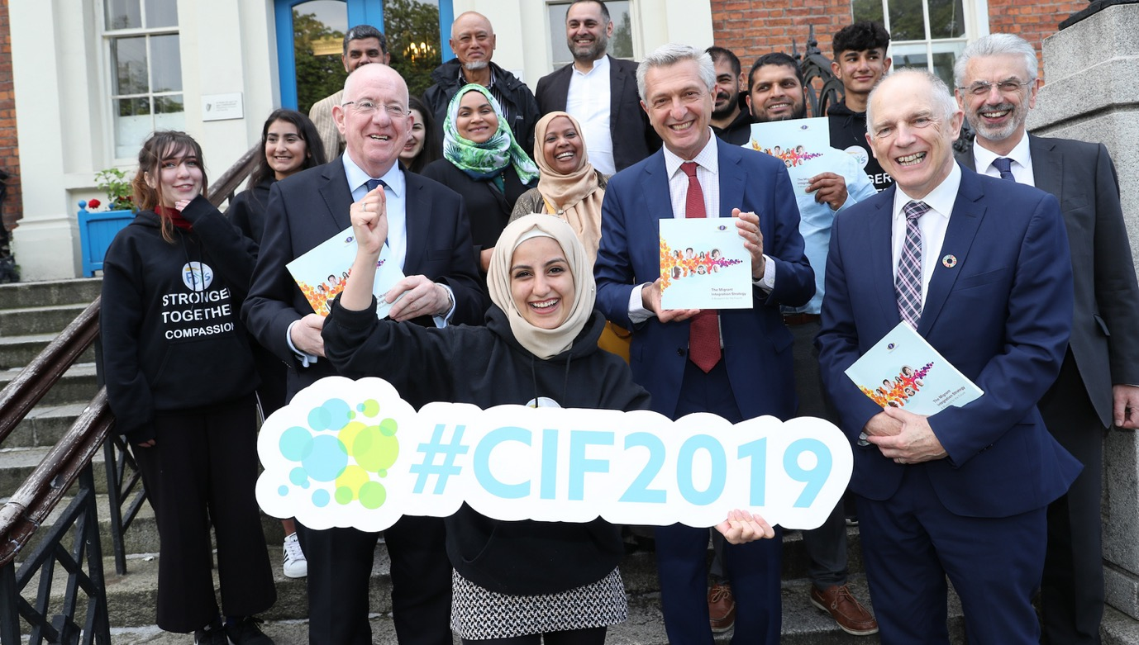
EXAMPLE:
A Public Call
Published by Goverment (Ireland)
Communities Integration Fund, Department of Justice
http://www.integration.ie/en/ISEC/Pages/WP18000024

Slide 15

EXAMPLE:
A Public Call
Published by a corporation
Dublin Airport Community Fund:
https://www.dublinairport.com/corporate/corporate-social-responsibility/community-fund

Slide 16
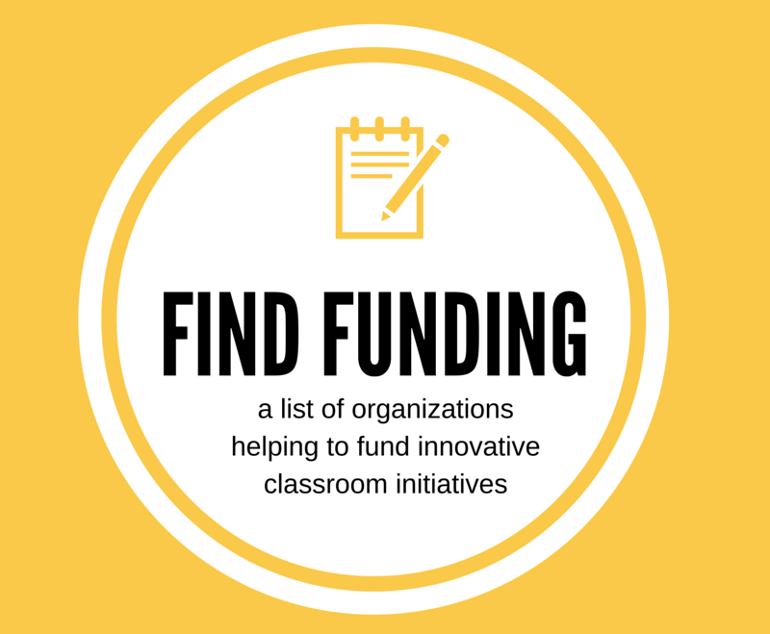
Your own initiative:
Search, not giving up, sending unsolicited proposals
Make a Connection
Ask Another Grantee
Go Out and Network
There is no harm in contacting foundations for an introduction. Ask them how you could interest them in supporting your project or how you can get onto the shortlist of organizations receiving an invitation.
This Photo by Unknown Author is licensed under CC BY-NC-ND

Slide 17
Applying for grant funding

Slide 18

Typical Project (Grant) Proposal Elements

Slide 19
Typical Project (grant) proposal elements
Summary
Write this at the end – repeat your best content
About the applicant
Don’t assume that the funder will have any knowledge of your initiative
Problem definition-justification
The power of evidence of need. it is not sufficient to say: “we know … we think….” back it up with relevant research
Cover letter
People need to be inspired by a vision.
Target group/beneficiaries
Who benefits most from the project? Align to funder target groups – research and repeat.

Slide 20
Typical Project (grant) proposal elements
Objectives
Focus on impact – see example to follow
Activities and Methodology- Time Plan
Important to show your capacity to deliver
Evaluation (success measuring)
Sustainability
Important to show the funder investment in you will have a lasting legacy
Budget
Annexes
Letters of support, the evidence of need report, financial info

Slide 21
Focus on Problem Solving
How will this grant tackle a challenge?
Problem statement – why is your project important? Justified? What problem does it solve?
How did you find out about the problem, what’s the research, statistics?
Multiple problems? Prioritize and choose!
What are the causes, solutions? Final solution. Evidence is the difference in success and failure

Slide 22


Objectives, Expected Results
Overall objective – long-term changes
Specific objectives – reachable, specific, clear
Expected results:
  services or products that will become available to beneficiaries
  Even more specific the specific objectives
  Examples: materials printed, people educated, outputs created, events attended

Slide 23

Budget: know your finances
Prepare your budget
Quotations and tender process
Know your employee costs
Know your overhead costs
Calculate volunteer contributions
Have your last year’s audited accounts ready
Financial projections – get a financial mentor or a volunteer to help

Slide 24

Sustainability – an opportunity to shine
How will impact continue?
Risks (internal, external)
Implementation:
monitoring
evaluation
reporting
TIP - Usually applicants do not give this section enough attention

Slide 25

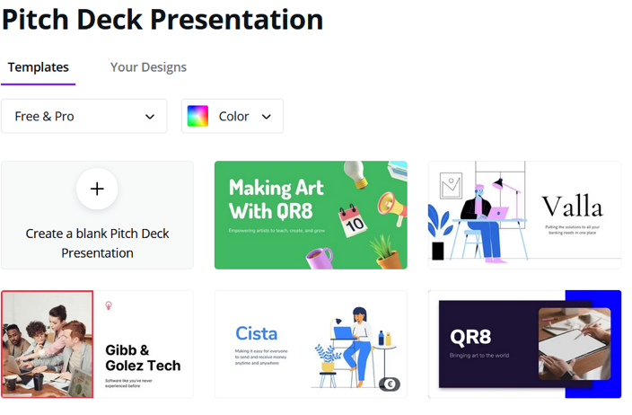
Some Top Tips:
Try a Pitch Deck
Whatever format funding, there is a moment when you will need to present your idea and ask for support. The better your presentation, your pitch, the better the chances are to be granted the funding and get the support you need.
Pitch deck is a set of free templates easily accessible on Canva.com, easily adaptable. They can be adapted to anyone’s needs, to pitch a business idea/project for potential funders.
A pitch deck is a brief presentation, often created using PowerPoint, Keynote or Prezi, and this time we chose Canva, used to provide your audience with a quick overview of your business plan. You will usually use your pitch deck during face-to-face or online meetings with potential investors, customers, partners, and co-founders.
CLICK on each image TO SEE

Slide 26
SOME TOP TIPS
Don’t assume that the funder will have any knowledge of your mediation initiative/advocacy, or background. Describe your project truthfully and fully
Break down the requirements of the application into bite-sized pieces
Think carefully about presentation; most funders will read many applications and if an application is easy to read and well presented it makes their lives easier
Do not over-promise - you will one day have to deliver
It always takes a lot longer to put an application for funds together than you think!

Slide 27

SOME TOP TIPS
Remember it is competitive – your best foot forward
Write in an interesting way that captures the energy & spirit of your project (journalist style)
The power of evidence of need. It is not sufficient to say: “we know … we think….” back it up with relevant research
Show that your project is additional – not competing with others
And last but not least, definitely talk to the funding agency before you apply

Slide 28
Identifying stakeholders and partners

Slide 29
What is a Stakeholder?
A stakeholder is anyone with a vested interest in your project. They will be affected by, or be able to affect, your cause.
Your stakeholders are a varied group, with varied interests!
Activity: Make a list of all the individuals, groups, companies, public institutions who are in any way connected to your mediation project

Slide 30
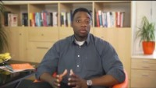
The Power of Stakeholders : WATCH THE VIDEO

Slide 31

Target groups, who will benefit.
  DIRECT + INDIRECT Target Group:
  click below to learn more
Whose problem is the project solving?
Describe the TARGET GROUP
Try to estimate how many, how big is the target group
Who can you partner with?
Does the Call ask you to? Who has the interest in this project? What is their relationship to the project?

Slide 32

Adjusting your proposal for different Funding Calls and Opportunities
Start with the funder’s OBJECTIVES e.g. active citizenship, inclusion, equality etc
Look for inclusion objectives, mix them in with other objectives
Find the connecting points
Determine what content can be reused
Look for key words – SWAP new key words
Research and check new data sources

Slide 33
RESOURCE - List of Opportunities and Resources -EU
Funding sources
and advice
Asylum, Migration and Integration Fund (AMIF)
European Social Fund
European Fund for Strategic Investments (EFSI)
European Structural and Investment Funds (ESIF)
Fund for European Aid for the Most Deprived (FEAD)
Internal Security Fund (ISF)
European Investment Project Portal
Employment and Social Innovation programme (EaSI)
Horizon 2020
URBACT
Urban Innovative Actions (UIA)
Advice and technical assistance
European Investment Advisory Hub (EIAH)
Joint Assistance to Support Projects in European Regions (JASPERS)
EU Skills Profile Tool for Third Country Nationals
References
Guidance note on the use of European structural and investment funds in tackling educational and spatial segregation (2015)
Beginner's Guide to EU Funding
Accessing regional-policy funds

Slide 34
RESOURCE - List of Opportunities and Resources -EU
Networking
European Integration Network (EIN)
European Migration Network (EMN)
Urban Agenda Partnership for the inclusion of migrants and refugees
ERASMI Project
Useful data sources and studies
Working Together for Local Integration of Migrants and Refugees, OECD 2018
Survey on immigrants' integration in the EU, 2017
Together in the EU: Promoting the participation of migrants and their descendants - EU Agency for Fundamental Rights
Eurostat: integration indicators including regional series
OECD database on migrants in OECD regions
Knowledge Centre on Migration and Demography
Data challenge on integration of migrants in cities
ESPON project on Territorial impact of refugees
International Ethnic and Immigrant Minorities' Survey Data

Slide 35

If the recipe isn’t right, and you don’t get the Grant,– be sure to use these rejections as a learning experience!
Encountering a no can be disheartening. But don’t let it get the better of you. Consider these steps to increase your chances of being reconsidered, improve your potential for obtaining financing in the future and in general relieve the stress of securing funding.
OVERCOMING A ‘NO’ WHEN SEEKING FUNDING
“Enthusiasm is common. Endurance is rare.”
- Angela Duckworth

Slide 36
Reflect on your approach - be honest with yourself. Did you rush the application? Did you really think you met the priorities or did you not do yourself justice in writing about your business idea?
Ask for feedback - even if your rejection letter specifies a reason for your rejection, asking for verbal feedback will sometimes bring you a fuller and more open response.
Act Professionally - Even though disheartened, keep your behaviour and actions as professional as possible. If you thank the possible supporter politely for his/her time, and follow up in a few weeks when you’ve gathered more information or adjusted your business model, you may have a much better chance of getting that funding.
OVERCOMING A ‘NO’ WHEN SEEKING FUNDING

Slide 37
Find out what did get funded – funders often publish lists of what they did fund.
What do you notice about the projects that got funded?
Were the businesses at a different stage to you?
Were you asking for much more (or less) money than they received?
Were you applying for activities that this funder hasn’t supported?
OVERCOMING A ‘NO’ WHEN SEEKING FUNDING

Slide 38

Crowdfunding: Powerful, Scary, Liberating

Slide 39

Crowdfunding: Powerful, Scary, Liberating
Crowdfunding is the financing of a new project by raising many small amounts of money from a large number of people.
Crowdfunding is not only a great way to raise money online for a project, but simultaneously build up a community and improve visibility/credibility for you and your mediation project.

Slide 40

Crowdfunding example
Activity: READ
Refugee and migrant charity food bank
https://www.crowdfunder.co.uk/voicesinexilefoodbank

Slide 41

Crowdfunding: Powerful, Scary, Liberating
READ
Crowdfunding for Non-Profits, Charitable Causes, and Social Activists
Crowdfunding can be instrumental in raising awareness and promoting a cause.
90% of funders went on to promote the project they supported, typically via social media.
Since crowdfunding raises money for specific projects, rather than organisations as a whole, it provides more transparency around what funds will be used for and how they will benefit others.

Slide 42
Crowdfunding Platforms - How does it work?
Different platforms apply different charges depending on the model you chose.
Platform Hosting fee: Some platforms, although not all, charge an initial cost just for hosting your campaign. Top tip - Make sure to ask platform what fee applies to them before starting the campaign.
Success fee: The majority of crowdfunding platforms will take a percentage of the total amount raised. The percentage varies from platform to platform and ranges between 3% and 12% of total raised.
Payment processing fees: Look out also for a service fee for every transaction made. Usually this fee is on average 3%. For instance, for every €100 donation/investment, only €97 reaches the campaign

Slide 43
5 Crowdfunding Websites for Not-For-Profits
Crowdfunder offers two different funding methods: All or Nothing (you only receive your pledges if you hit your target) and Keep What You Raise (you get to keep all your pledges, whether your projects hits target or not). The latter is best suited for causes or charitable projects.
CrowdFundMe allows pretty much any project regardless of whether it’s a commercial or social idea. They only allow ‘All or nothing’ type of funding, which means that if you don’t raise all the money set as target, it goes back to the donors.
Kickstarter is a widely known crowdfunding platform aimed at creative projects. Project creators choose a deadline and minimum funding goal and if the goal isn’t met by the deadline, no funds are collected. Those who back Kickstarter projects are offered rewards for their pledges.
Generosity is Indiegogo’s charity crowdfunding platform, which was specifically designed for the needs of socially minded not-for-profits and individuals looking to solve both personal and community challenges. The platform does not take any fee out of the money raised; however, payment processor fees may apply.
GoFundMe is a crowdfunding platform that enables people to raise money for different life events. Supported countries and currencies include United States of America ($USD), United Kingdom (£GBP), Canada ($CAD), Australia ($AUD), and some European Union countries that use the Euro as their official currency (€EUR). With GoFundMe, you keep each and every donation you receive; reaching your goal is not required.

Slide 44
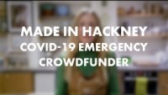
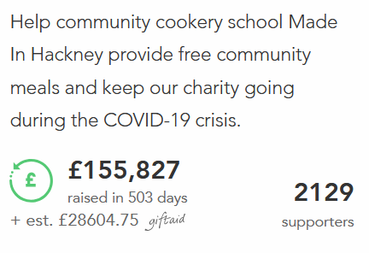
Watch the sucessful crowdfunding video pitch:
Community Food Response
Crowd Funding – A Good Video Pitch is Key!
Excellent video pitches are essential to successful crowdfunding campaigns.
But pitching your idea takes practice, preparation and perseverance.
Do your research, by viewing other video pitches.
Write a compelling script that communicates your unique selling points simply and clearly.
Record the vision with passion and enthusiasm – it is infectious and will give the viewer confidence in your commitment
Reshoot it until it’s right.

Slide 45
Volunteers and community engagement in using the resources

Slide 46
Why is a tribe so important?
“If you want to go fast, go alone. If you want to go far, go together.”
African proverb
Collaboration, commitment, connection are key to tribal life & work.
As a someone who helps others all the time, you may sometimes feel like no one is there for you, without any resources to utilise but your own.
Finding your tribe/building your community gives you access to a built-in coalition of collaborators, a ready-made group to provide support and encouragement who are their to help you achieve your social mission.
The community begins with you, believing and trusting in yourself, your cause and your abilities to make the world a better place. From there, you attract your tribe. Remember the seeds you plant are what you’ll end up harvesting.

Slide 47
ONLINE COMMUNITIES MORE IMPORTANT THAN EVER
It’s a great way to reach people who you might not otherwise meet. Now more than ever online communities have been a lifeline to people.
With so many people isolating and so many events cancelled, people have been at a loss.
They’ve missed the social interaction and the online community has bridged that gap and formed groups that will last long after the pandemic.

Slide 48

BENEFITS OF BUILDING AN ONLINE COMMUNITY
Fundraise more effectively
Social collaboration, knowledge exchange and problem solving
MESSAGE AWARENESS
Unlock an advocate and volunteer support base

Slide 49




KNOWLEDGE YOU NEED TO GROW AN ONLINE COMMUNITY
YOUR ADVOCACY MESSAGE
This is what brings your community togerther
YOUR TARGET GROUPS
Define your target group and always be aware of their needs
EMOTIONAL CONNECTION
Strive to create one with your target groups
DIGITAL TOOLS
Spaces and tools to help you grpe your online community

Slide 50



Tools for Building an Online Community and Fundraising Online
Bring your exhisting community to your online channel and find new members, using online tools

Slide 51
Twitter is a powerful tool for building an online community and tribe. We are all drawn to people who share our passions and on twitter it is very easy to follow and engage with people who share your passions
World Economic Forum has even embraced TikTok with their #allthedifference campaign, below are the details:
Join our TikTok challenge
We’re celebrating your differences. Show us what makes you unique, how you cast off the labels, or what you’ve done to make the world a more tolerant place. One where no one is excluded because of their race, religion, gender, disability or sexual orientation. Your stories could make #allthedifference
Facebook Resource Groups (FBRGs)
Facebook Resource Groups (FBRGs) are inclusive groups that provide community support crucial to achieving our mission and created a space where employees feel seen, heard and a sense of belonging. These groups focus on characteristics shared by people in traditionally underrepresented and marginalized spheres. They help participants become catalysts for ensuring a fully inclusive and open environment that provides opportunities for everyone to contribute to Facebook’s success:
https://diversity.fb.com/initiative/facebook-resource-groups/

Slide 52

DEFINING SUCCESS

Slide 53
SUCCESS – WHAT DOES IT LOOK LIKE?
We all see success differently. Our aspirations are influenced by our upbringing, our environment, our image of ourselves, and the people we live and work alongside in our new communities.
As a person with migration experience, your background and the challenges you have overcome are part of your motivation to succeed.
Success can be complex, but it can also be quite simple.

Slide 54

HOW IS SUCCESS DEFINED?
1. the attainment of fame, wealth, or social status
2. the accomplishment of an aim or purpose
3. a person or thing that achieves desired aims
A combination of the above? Or something else?

Slide 55

DEFINING SUCCESS ON YOUR OWN TERMS
Every experience that we go through presents an opportunity to learn about ourselves and the world around us.
By seeking to find the lessons learned in our past you will be able to articulate better what you want to achieve in your life moving forward, both personally and professionally.
Stop comparing yourself to others or wondering how your life “should” look. Realising that the definition of success is different for every single person out there is important.

Slide 56

You matter! Your questions, ideas, your experience matters.
Join the conversation of our social media channels
We are honoured that you have been with us and have used these resources to find out more about peer-to-peer mediation, among people who have had the migration experience in their lives.
We hope you have enjoyed these resources as much as we did creating them for you.
Please take this with you:
Every time a friendly act is made towards the new community members, the foundations for a brighter futures are being set!
Congratulations!
YOU HAVE COMPLETED OUR LEARNING JOURNEY
We are proud of you, your MCM project team.

